Slide 1
רשתות תקשורת מחשבים
פרק 4 - שכבת הרשת
עמית דביר
amitdv@ariel.ac.il
מעבדת סייבר 56.0.49

Slide 2
Network Switching

Slide 3
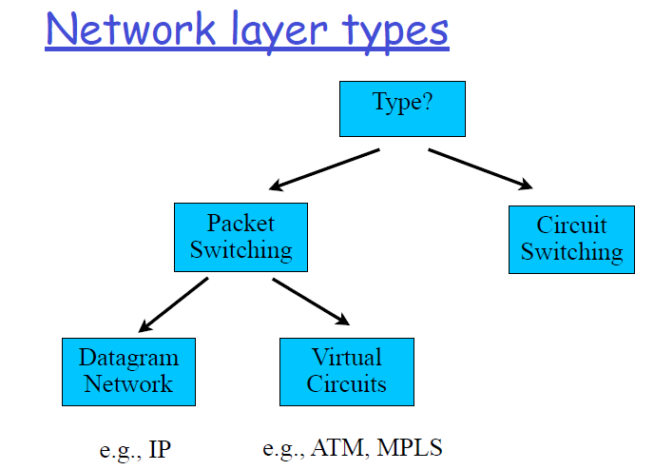

Slide 4

Virtual circuits
Call setup, teardown for each call before data can flow
Each packet carries VC identifier (not destination host address)
Every router on source-dest path maintains “state” for each passing connection
Link, router resources (bandwidth, buffers) may be allocated to VC (dedicated resources = predictable service)
application
transport
network
data link
physical
application
transport
network
data link
physical
5. data flow begins
6. receive data
4. call connected
3. accept call
1. initiate call
2. incoming call
“source-to-dest path behaves much like telephone circuit”
performance-wise network actions along source-to-dest path

Slide 5
Datagram networks
no call setup at network layer
routers: no state about end-to-end connections
no network-level concept of “connection”
packets forwarded using destination host address
application
transport
network
data link
physical
application
transport
network
data link
physical
1. send datagrams
2. receive datagrams

Slide 6
IP Datagrams on Virtual Circuits
Challenge – when to setup connections
At bootup time – permanent virtual circuits (PVC)
Large number of circuits
For every packet transmission
Connection setup is expensive
For every connection
What is a connection?
How to route connectionless traffic?

Slide 7
Source Routing
List entire path in packet
Driving directions (north 3 hops, east, etc..)
Router processing
Examine first step in directions
Strip first step from packet
Forward to step just stripped off
Packet
R2, R3, R
R3, R
2
2
Sender
R1
R2
1
3
1
3
4
4
R
2
1
R3
Receiver
4
3

Slide 8
תרגיל
אילו סוגים של רשתות אתם מכירים
Packet switching
Circuit Switching
Virtual Circuit
Source Routing
Global Addresses
Virtual Circuits
Header Size
Router Table Size
Forward Overhead
Setup Overhead
Error Recovery

Slide 9
Summary
Source Routing
Global Addresses
Virtual Circuits
Header Size
Worst
OK – Large address
Best
Router Table Size
None
Number of hosts (prefixes)
Number of circuits
Forward Overhead
Best
Prefix matching
Pretty Good
Setup Overhead
None
None
Connection Setup
Error Recovery
Tell all hosts
Tell all routers
Tell all routers and Tear down circuit and re-route
Notes:
Run: route PRINT or netstat –rn and see the routing table.
Default route, default gateway
Direct delivery to the LAN-located computer and sending to the gateway for all other cases

Slide 10
DHCP

Slide 11
IP addresses: how to get one?
Q: How does host get IP address?
1. hard-coded by system admin in a file
2. DHCP: Dynamic Host Configuration
Protocol: dynamically get address from a
server

Slide 12
DHCP: Dynamic Host Configuration Protocol
Goal: allow host to dynamically obtain its IP address from network server when it joins network
Can renew its lease on address in use
Allows reuse of addresses (only hold address while connected an “on”
Support for mobile users who want to join network

Slide 13
DHCP overview
Discover: Host broadcasts “DHCP
discover” msg
Offer: DHCP server responds with “DHCP
offer” msg
Request: host requests IP address:
“DHCP request” msg
Acknowledge: DHCP server sends
address: “DHCP ack” msg

Slide 14


DHCP client-server scenario
DHCP
server
223.1.1.0/24
223.1.1.1
223.1.2.1
223.1.1.2
arriving DHCP
client needs
address in this
network
223.1.1.4
223.1.2.9
223.1.3.27
223.1.2.2
223.1.1.3
223.1.2.0/24
223.1.3.1
223.1.3.2
223.1.3.0/24

Slide 15
DHCP client-server scenario
DHCP discover
src : 0.0.0.0, 68
dest.: 255.255.255.255,67
yiaddr: 0.0.0.0
transaction ID: 654
DHCP offer
src: 223.1.2.5, 67
dest: 255.255.255.255, 68
yiaddrr: 223.1.2.4
transaction ID: 654
lifetime: 3600 secs
DHCP request
src: 0.0.0.0, 68
dest:: 255.255.255.255, 67
yiaddrr: 223.1.2.4
transaction ID: 655
lifetime: 3600 secs
DHCP ACK
src: 223.1.2.5, 67
dest: 255.255.255.255, 68
yiaddrr: 223.1.2.4
transaction ID: 655
lifetime: 3600 secs
DHCP server: 223.1.2.5
arriving client

Slide 16
Soft State: Refresh or Forget
Why is a lease time necessary?
Client can release the IP address (DHCP RELEASE)
E.g., “ipconfig /release” at the DOS prompt
E.g., clean shutdown of the computer
But, the host might not release the address
E.g., the host crashes (blue screen of death!)
E.g., buggy client software
And you don’t want the address to be allocated forever
Performance trade-offs
Short lease time: returns inactive addresses quickly
Long lease time: avoids overhead of frequent renewals

Slide 17
DHCP: more than IP addresses
DHCP can return more than just allocated IP address on subnet:
address of first-hop router for client
name and IP address of DNS sever
network mask (indicating network versus host portion of address)

Slide 18


DHCP: example
connecting laptop needs its IP address, addr of first-hop router, addr of DNS server: use DHCP
DHCP
UDP
IP
Eth
Phy
DHCP request encapsulated in UDP, encapsulated in IP, encapsulated in 802.1 Ethernet
DHCP
DHCP
DHCP
DHCP
Ethernet frame broadcast (dest: FFFFFFFFFFFF) on LAN, received at router running DHCP server
DHCP
DHCP
DHCP
UDP
IP
Eth
Phy
168.1.1.1
DHCP
DHCP
DHCP
Ethernet demuxed to IP demuxed, UDP demuxed to DHCP
DHCP
router with DHCP
server built into
router

Slide 19
DHCP: example
DCP server formulates DHCP ACK containing client’s IP address, IP address of first-hop router for client, name & IP address of DNS server
DHCP
DHCP
UDP
IP
Eth
Phy
encapsulation of DHCP server, frame forwarded to client, demuxing up to DHCP at client
DHCP
DHCP
DHCP
client now knows its IP address, name and IP address of DSN server, IP address of its first-hop router
DHCP
DHCP
UDP
IP
Eth
Phy
DHCP
DHCP
DHCP
router with DHCP
server built into
router
DHCP

Slide 20
DHCP: Wireshark output (home LAN)
request
reply
Message type: Boot Request (1)
Hardware type: Ethernet
Hardware address length: 6
Hops: 0
Transaction ID: 0x6b3a11b7
Seconds elapsed: 0
Bootp flags: 0x0000 (Unicast)
Client IP address: 0.0.0.0 (0.0.0.0)
Your (client) IP address: 0.0.0.0 (0.0.0.0)
Next server IP address: 0.0.0.0 (0.0.0.0)
Relay agent IP address: 0.0.0.0 (0.0.0.0)
Client MAC address: Wistron_23:68:8a (00:16:d3:23:68:8a)
Server host name not given
Boot file name not given
Magic cookie: (OK)
Option: (t=53,l=1) DHCP Message Type = DHCP Request
Option: (61) Client identifier
Length: 7; Value: 010016D323688A;
Hardware type: Ethernet
Client MAC address: Wistron_23:68:8a (00:16:d3:23:68:8a)
Option: (t=50,l=4) Requested IP Address = 192.168.1.101
Option: (t=12,l=5) Host Name = "nomad"
Option: (55) Parameter Request List
Length: 11; Value: 010F03062C2E2F1F21F92B
1 = Subnet Mask; 15 = Domain Name
3 = Router; 6 = Domain Name Server
44 = NetBIOS over TCP/IP Name Server
……
Message type: Boot Reply (2)
Hardware type: Ethernet
Hardware address length: 6
Hops: 0
Transaction ID: 0x6b3a11b7
Seconds elapsed: 0
Bootp flags: 0x0000 (Unicast)
Client IP address: 192.168.1.101 (192.168.1.101)
Your (client) IP address: 0.0.0.0 (0.0.0.0)
Next server IP address: 192.168.1.1 (192.168.1.1)
Relay agent IP address: 0.0.0.0 (0.0.0.0)
Client MAC address: Wistron_23:68:8a (00:16:d3:23:68:8a)
Server host name not given
Boot file name not given
Magic cookie: (OK)
Option: (t=53,l=1) DHCP Message Type = DHCP ACK
Option: (t=54,l=4) Server Identifier = 192.168.1.1
Option: (t=1,l=4) Subnet Mask = 255.255.255.0
Option: (t=3,l=4) Router = 192.168.1.1
Option: (6) Domain Name Server
Length: 12; Value: 445747E2445749F244574092;
IP Address: 68.87.71.226;
IP Address: 68.87.73.242;
IP Address: 68.87.64.146
Option: (t=15,l=20) Domain Name = "hsd1.ma.comcast.net."

Slide 21
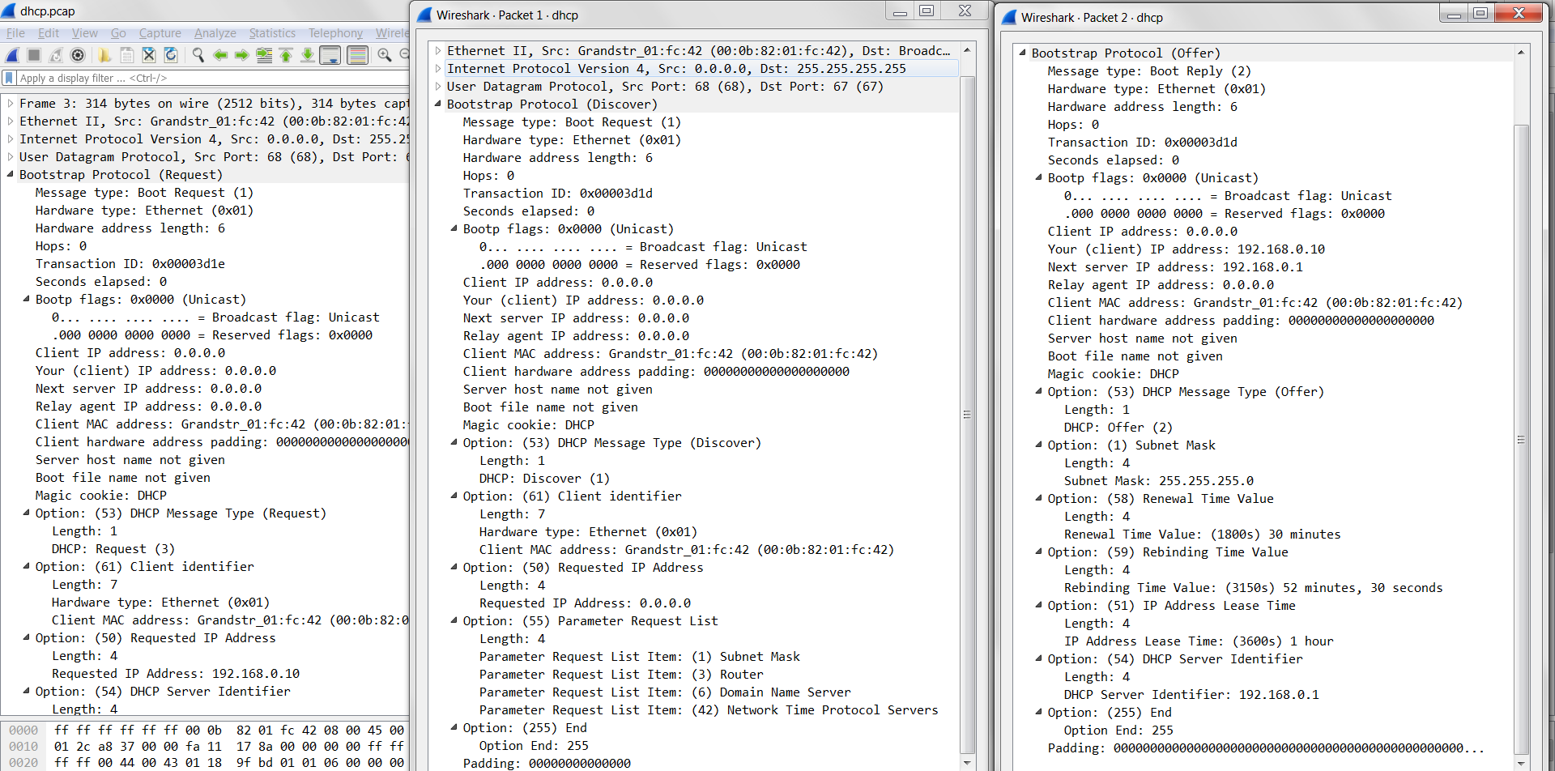
DHCP: Wireshark output (home LAN)

Slide 22
תרגיל
מה אפשרויות למחשב לקבל IP?
תצורה סטאטית - הגדרות המחשב
תצורה דינמית – DHCP
2) למה אנחנו צריכים שרת DHCP?
מישהו צריך לרכז מי קיבל מה
מה היתרון של ארבעת ההודעות
האפשרות שמספר שרתים יענו לי ובכך השרתים ידעו איזה כתובת לקחתי
מה קורה כאשר יש לנו רשת עם נתבים, האם יש צורך בשרת תחת כל subnet
לא

Slide 23
Computer Networks IP: Internet Protocol
Notes:
הגעתי

Slide 24
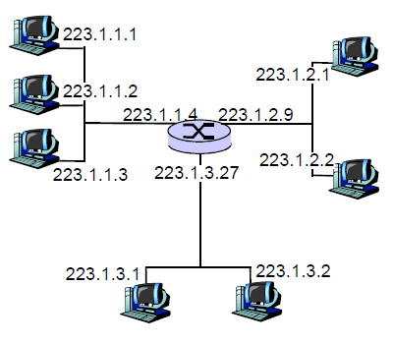
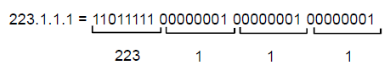
IP Addressing
IP address: 32-bit identifier
interface: connection between host/router and physical link
router’s typically have multiple interfaces
host typically has one interface
IP addresses associated with each interface

Slide 25
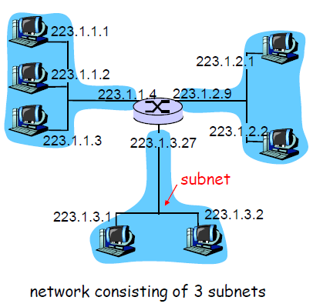
IP Addressing
IP address:
subnet part (high order bits)
host part (low order bits)
What’s a subnet ?
device interfaces with same subnet part of IP address can physically reach each other without intervening router

Slide 26
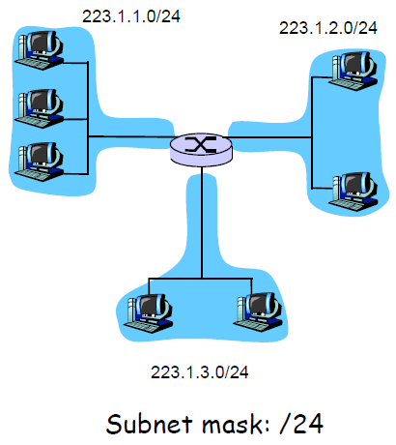
Subnets
To determine the subnets, detach each interface from its host or router, creating islands of isolated networks.
Each isolated network is called a subnet.
Subnet mask: number of leftmost bits in IP addresses that define the subnet address

Slide 27
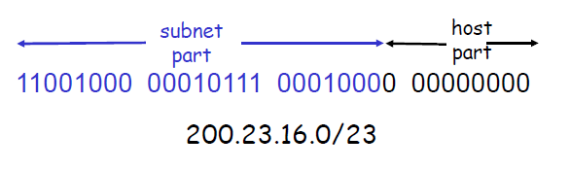
IP addressing: CIDR
CIDR: Classless InterDomain Routing
subnet portion of address of arbitrary length
address format: a.b.c.d/x, where x is # bits in subnet portion of address

Slide 28
CIDR Illustration
Provider is given 201.10.0.0/21
Provider
201.10.0.0/22
201.10.4.0/24
201.10.5.0/24
201.10.6.0/23

Slide 29
CIDR Implications
Longest prefix match!!
201.10.0.0/21
201.10.6.0/23
Provider 1
Provider 2
201.10.0.0/22
201.10.4.0/24
201.10.5.0/24
201.10.6.0/23 or Provider 2 address

Slide 30
Hierarchical addressing: route aggregation
hierarchical addressing allows efficient advertisement of routing
information:
Organization 0
200.23.16.0/23
Organization 1
200.23.18.0/23
“Send me anything
with addresses
beginning
200.23.16.0/20”
Organization 2
200.23.20.0/23
.
Fly-By-Night-ISP
.
.
.
.
Internet
Organization 7
.
200.23.30.0/23
ISPs-R-Us
“Send me anything
with addresses
beginning
199.31.0.0/16”

Slide 31
Hierarchical addressing: more specific routes
ISPs-R-Us has a more specific route to Organization 1
Organization 0
200.23.16.0/23
“Send me anything
with addresses
beginning
200.23.16.0/20”
Organization 2
200.23.20.0/23
.
Fly-By-Night-ISP
.
.
.
.
Internet
Organization 7
.
200.23.30.0/23
ISPs-R-Us
“Send me anything
with addresses
beginning 199.31.0.0/16
or 200.23.18.0/23”
Organization 1
200.23.18.0/23

Slide 32
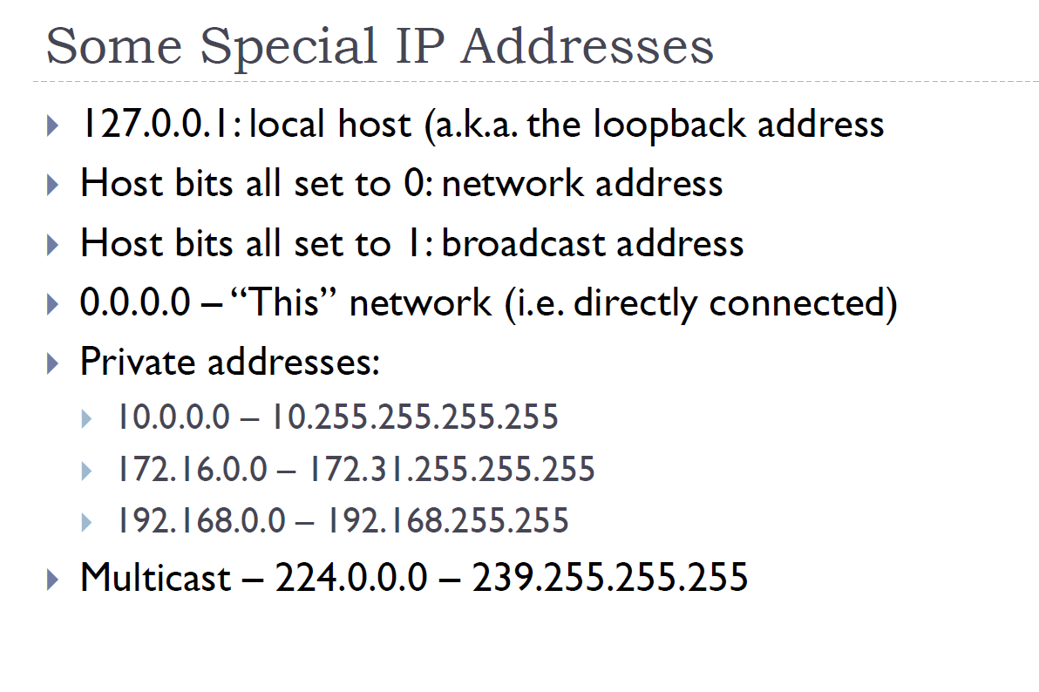

Slide 33
Router

Slide 34
Generic Router Architecture
Header Processing
Data
Hdr
Lookup
IP Address
Update
Header
Queue
Packet
Data
Hdr
IP Address
Next Hop
Address
Table
Buffer
Memory
1M prefixes
Off-chip DRAM
1M packets
Off-chip DRAM

Slide 35
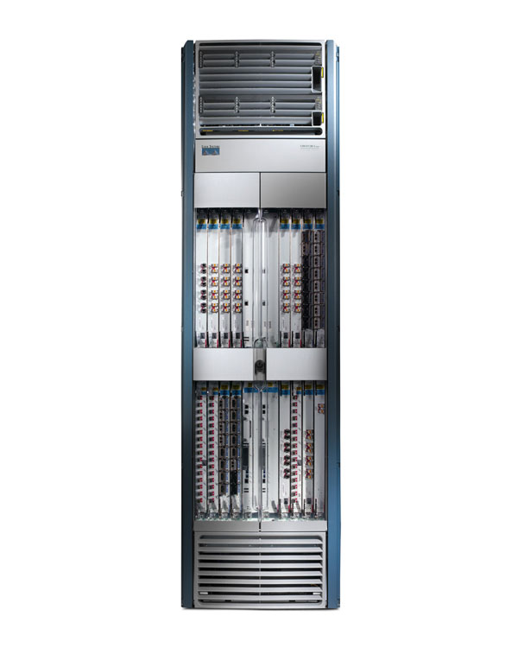
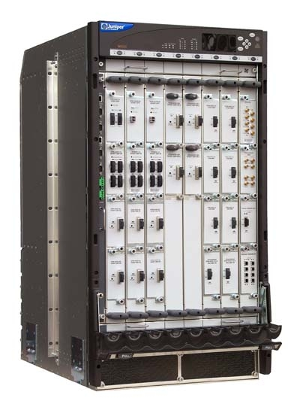
What a Router Chassis Looks Like
19”
17”
Capacity: 1.2Tb/s Power: 10.4kW Weight: 0.5 Ton Cost: $500k
Capacity: 320 Gb/s Power: 3.1kW
6ft
3ft
Cisco CRS-1
2ft
2ft
Juniper M320

Slide 36
IP Lookups find Longest Prefixes
128.9.176.0/24
128.9.16.0/21
128.9.172.0/21
65.0.0.0/8
142.12.0.0/19
128.9.0.0/16
0
128.9.16.14
2³²-1
Routing lookup: Find the longest matching prefix (aka the most specific route) among all prefixes that match the destination address.

Slide 37
IP Address Lookup: Binary Tries
0
1
Example Prefixes:
a) 00001
b) 00010
c) 00011
d) 001
g
e) 0101
d
f
f) 011
g) 100
h
i
h) 1010
e
i) 1100
a
b
c
j) 11110000
j

Slide 38
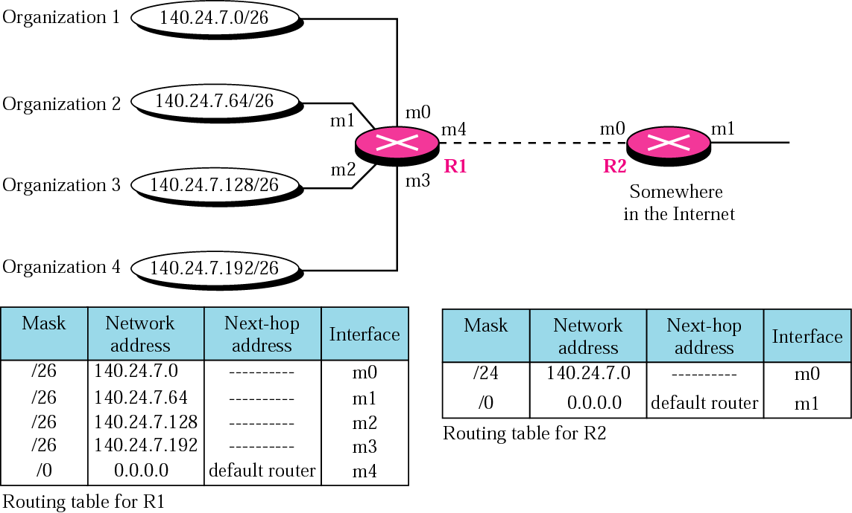
Address aggregation

Slide 39
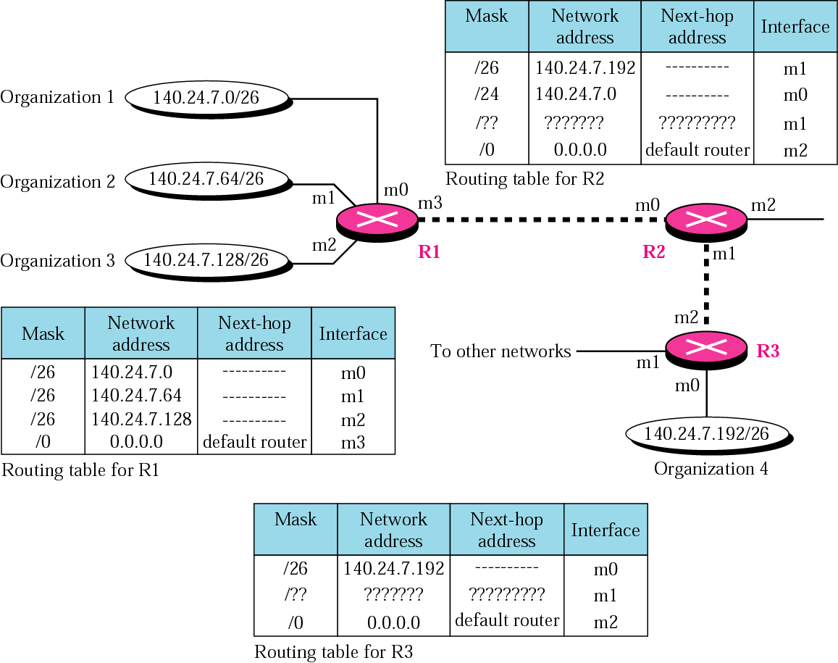
Longest mask matching

Slide 40
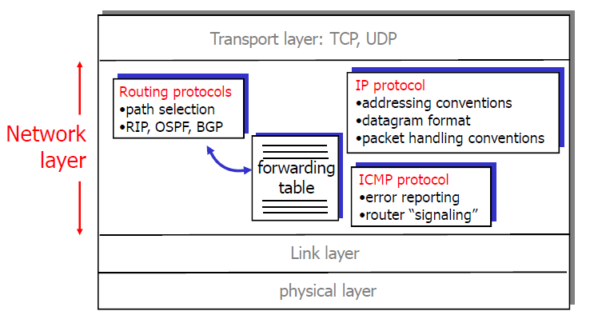
The Internet Network layer
Host, router network layer functions:

Slide 41
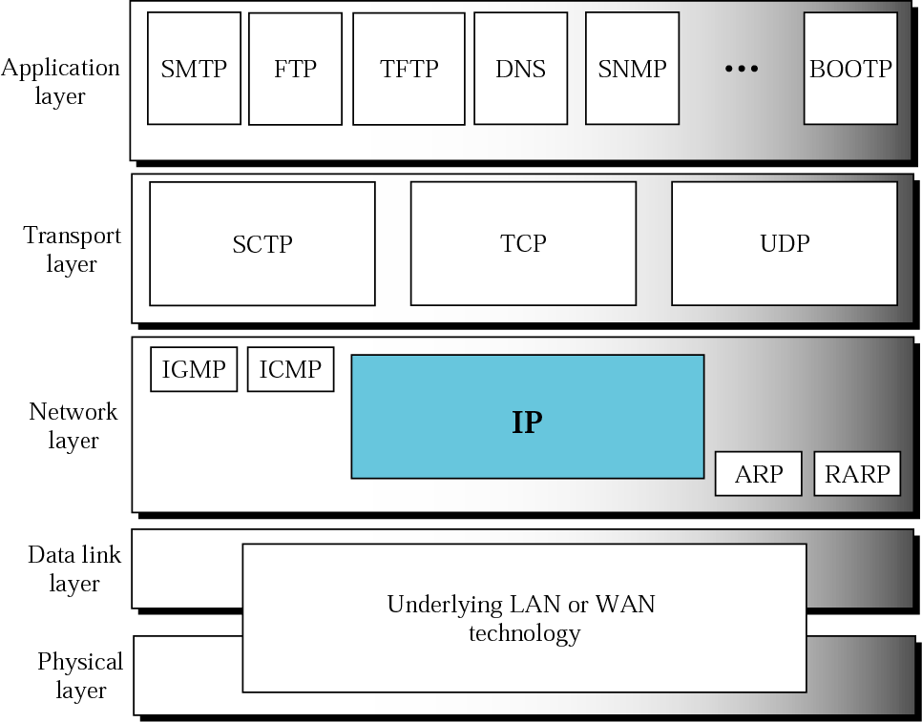
Where are we ?

Slide 42
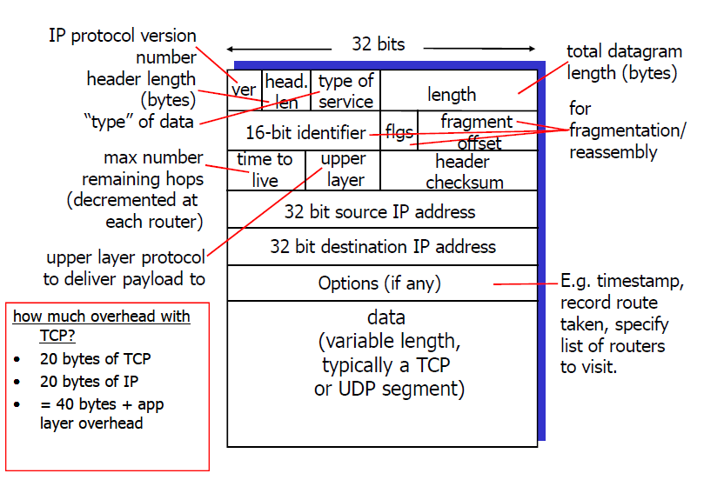
IP datagram format

Slide 43
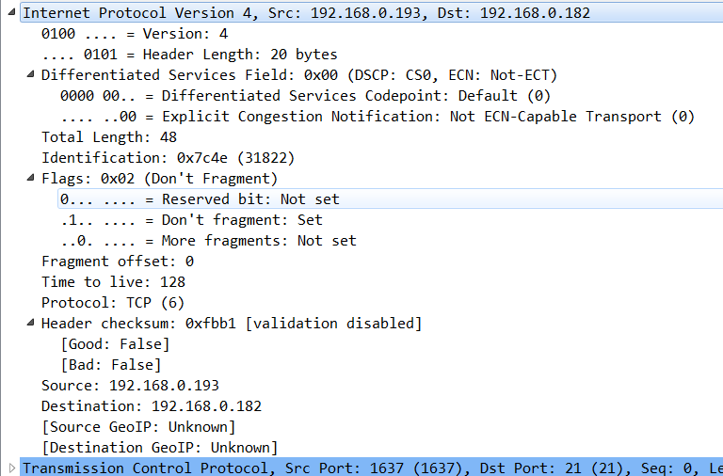

Slide 44
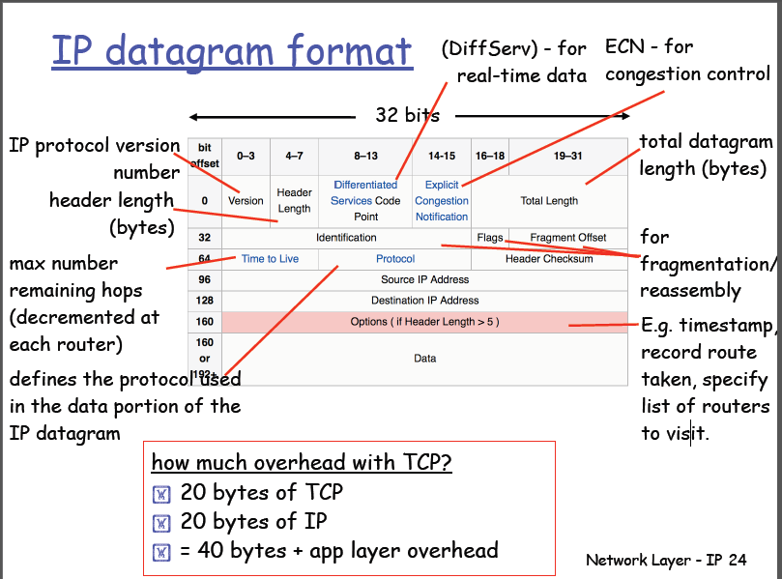
Notes:
להסביר שבממוצע בגלל ה-TCP options זה גדל ל-40

Slide 45
IPv4 Header Fields
Version: IP Version
4 for IPv4
HLen: Header Length
32-bit words (typically 5)
TOS: Type of Service
Priority information
0
4
8
12
16
19
24
28
31
ver-
sion
HLen
TOS
Length
Identifier
Flags
Offset
TTL
Protocol
Checksum
Source Address
Destination Address
Options (if any)
Data
Length: Packet Length
Bytes (including header)
Header format can change with versions
First byte identifies version
Length field limits packets to 65,535 bytes
In practice, break into much smaller packets for network performance considerations

Slide 46
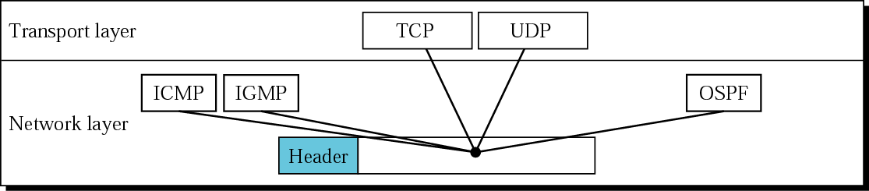
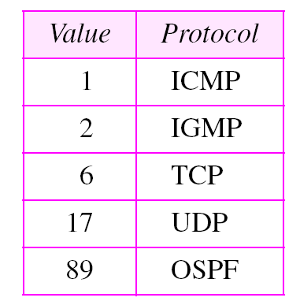
IPv4 Header Fields
Identifier, flags, fragment offset → used primarily for fragmentation
Time to live
Must be decremented at each router
Packets with TTL=0 are thrown away
Ensure packets exit the network
Protocol
Demultiplexing to higher layer protocols
TCP = 6, ICMP = 1, UDP = 17…
Header checksum
Ensures some degree of header integrity
Relatively weak – 16 bit
Options
E.g. Source routing, record route, etc.
Performance issues
Poorly supported
0
4
8
12
16
19
24
28
31
ver-
sion
HLen
TOS
Length
Identifier
Flags
Offset
TTL
Protocol
Checksum
Source Address
Destination Address
Options (if any)
Data

Slide 47
IPv4 Header Fields
Source Address
32-bit IP address of sender
Destination Address
32-bit IP address of destination
0
4
8
12
16
19
24
28
31
ver-
sion
HLen
TOS
Length
Identifier
Flags
Offset
TTL
Protocol
Checksum
Source Address
Destination Address
Options (if any)
Data
Like the addresses on an envelope
Globally unique identification of sender & receiver

Slide 48
תרגיל
מה משמעות שדה ה-TTL
למרות שהוא מוגדר כ-Time to leave, מדובר על כמות הנתבים שמותר לחבילה לעבור בדרך
2) מדוע יש שדה ID למרות שב-TCP יש seqNum
כל שכבה עומדת בפני עצמה, לדוגמא מה יקרה אם בשכבת התעבורה יעבוד UDP

Slide 49
IP Fragmentation and Reassembly
Network links have MTU (max. transfer size)
– largest possible link-level frame.
Different link types, different MTUs
Ethernet: 1500 bytes
Some WANs: 576 bytes
Large IP datagram divided (“fragmented”)
within net
One datagram becomes several datagrams
“reassembled” only at final destination
IP header bits used to identify, order related
fragments

Slide 50
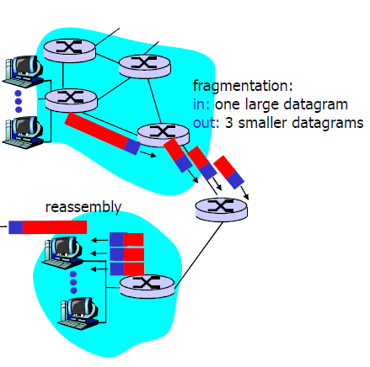
IP Fragmentation and Reassembly
Notes:
אריאל ערב

Slide 51
IP Fragmentation Example #1
router
host
MTU = 4000
Length = 3820, M=0
IP
Header
IP
Data

Slide 52
IP Fragmentation Example #2
MTU = 2000
router
router
Length = 2000, M=1, Offset = 0
Length = 3820, M=0
IP
Header
IP
Data
IP
Header
IP
Data
1980 bytes
3800 bytes
Length = 1840, M=0, Offset = 1980
IP
Header
IP
Data
1820 bytes

Slide 53
IP Fragmentation Example #3
Length = 1500, M=1, Offset = 0
host
IP
Header
IP
Data
router
MTU = 1500
Length = 2000, M=1, Offset = 0
1480 bytes
IP
Header
IP
Data
Length = 520, M=1, Offset = 1480
IP
Header
IP
Data
1980 bytes
Length = 1500, M=1, Offset = 1980
IP
Header
IP
Data
500 bytes
Length = 1840, M=0, Offset = 1980
Length = 360, M=0, Offset = 3460
IP
Header
IP
Data
IP
Header
IP
Data
1480 bytes
1820 bytes
340 bytes

Slide 54
IP Reassembly
Fragments might arrive out-of-order
Don’t know how much memory required until receive final fragment
Some fragments may be duplicated
Keep only one copy
Some fragments may never arrive
After a while, give up entire process
Length = 1500, M=1, Offset = 0
IP
Header
IP
Data
Length = 520, M=1, Offset = 1480
IP
Header
IP
Data
Length = 1500, M=1, Offset = 1980
IP
Header
IP
Data
Length = 360, M=0, Offset = 3460
IP
Header
IP
Data
IP
Data
IP
Data
IP
Data
IP
Data

Slide 55
Fragmentation Concepts
Highlights many key Internet characteristics
Decentralized and heterogeneous
Each network may choose its own MTU
Connectionless datagram protocol
Each fragment contains full routing information
Fragments can travel independently, on different paths
Best effort network
Routers/receiver may silently drop fragments
No requirement to alert the sender
Most work is done at the endpoints
i.e. reassembly

Slide 56
Fragmentation in Reality
Fragmentation is expensive
Memory and CPU overhead for datagram reconstruction
Want to avoid fragmentation if possible
MTU discovery protocol
Send a packet with “don’t fragment” bit set
Keep decreasing message length until one arrives
May get “can’t fragment” error from a router, which will explicitly state the supported MTU
Router handling of fragments
Fast, specialized hardware handles the common case
Dedicated, general purpose CPU just for handling fragments

Slide 57
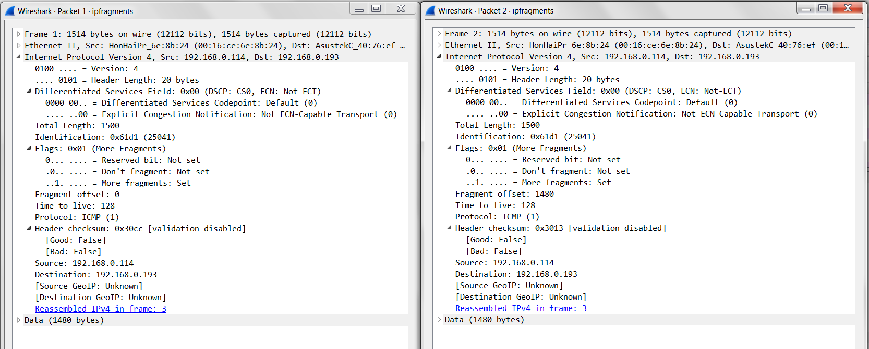

Slide 58
ICMP

Slide 59
ICMP: internet control message protocol
used by hosts & routers to communicate network-level information
error reporting: unreachable host, network, port, protocol
echo request/reply (used by ping)
network-layer “above” IP:
ICMP msgs carried in IP datagrams
ICMP message: type, code plus first 8 bytes of IP datagram causing error
Type Code description
0 0 echo reply (ping)
3 0 dest. network unreachable
3 1 dest host unreachable
3 2 dest protocol unreachable
3 3 dest port unreachable
3 6 dest network unknown
3 7 dest host unknown
4 0 source quench (congestion
control - not used)
8 0 echo request (ping)
9 0 route advertisement
10 0 router discovery
11 0 TTL expired
12 0 bad IP header
Notes:
לתת דגש על הנושא למרות שיש קצת שקפים

Slide 60
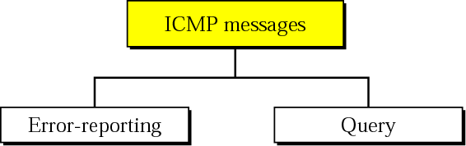
Overview
IP deficiencies: Lack of error control and assistance mechanisms
The Internet Control Message Protocol (ICMP) is a helper protocol that supports IP with facility for
Error reporting
Simple queries

Slide 61
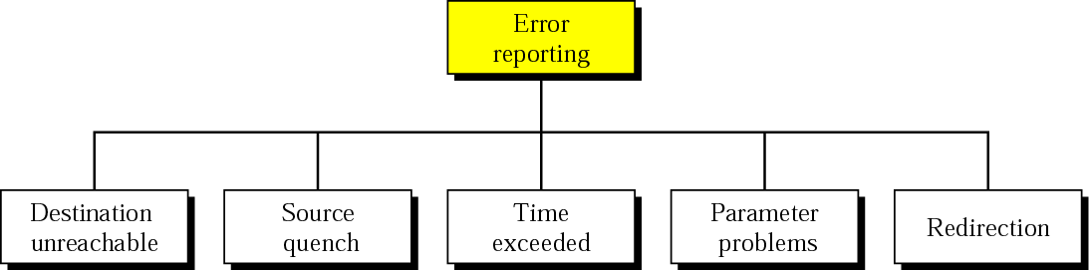
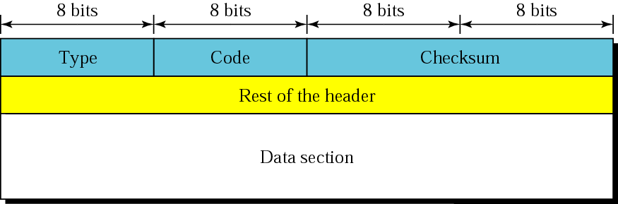
ERROR REPORTING
ICMP does not correct errors, it simply reports them.
ICMP always reports error messages to the original source.
No ICMP error message will be generated in response to a datagram carrying an ICMP error message.
Checksum: Calculated over entire ICMP message

Slide 62
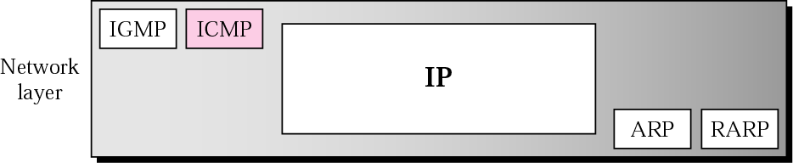
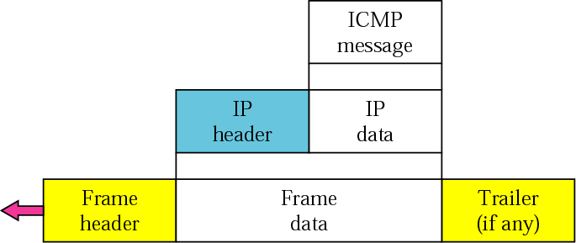
Position of ICMP in the network layer & encapsulation

Slide 63
Frequent ICMP Error message
Type | Code | Description
3 | 0–15 | Destination unreachable | Notification that an IP datagram could not be forwarded and was dropped. The code field contains an explanation.
4 | 0 | Source Quench | Notification that an IP datagram has been discarded due to congestion in a router or the dest. host. The source must slow down the sending of datagrams until the congestion is relieved
5 | 0–3 | Redirect | Informs about an alternative route for the datagram and should result in a routing table update. The code field explains the reason for the route change.
11 | 0, 1 | Time exceeded | Sent when the TTL field has reached zero (Code 0) or when there is a timeout for the reassembly of segments (Code 1)
12 | 0, 1 | Parameter problem | Sent when the IP header is invalid (Code 0) or when an IP header option is missing (Code 1)

Slide 64
Some subtypes of the “Destination Unreachable”
Code | Description | Reason for Sending
0 | Network Unreachable | No routing table entry is available for the destination network.
1 | Host Unreachable | Destination host should be directly reachable, but does not respond to ARP Requests or due to hardware failure.
2 | Protocol Unreachable | The protocol in the protocol field of the IP header is not supported at the destination.
3 | Port Unreachable | The transport protocol at the destination host cannot pass the datagram to an application.
4 | Fragmentation Needed and DF Bit Set | IP datagram must be fragmented, but the DF bit in the IP header is set.

Slide 65
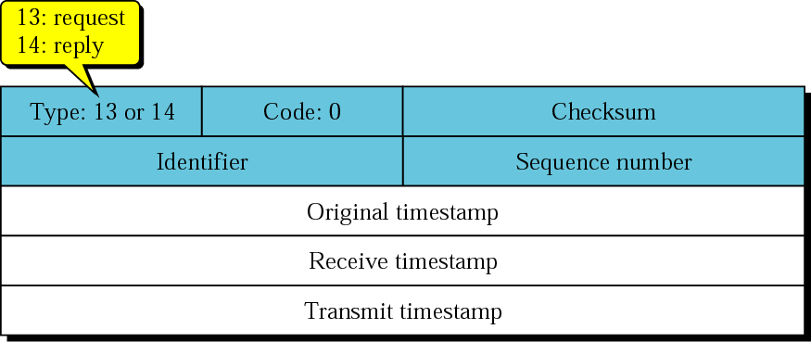
Timestamp-request and timestamp-reply message format
A system (host or router) asks another system for the current time.
Time is measured in milliseconds after midnight UTC (Universal Coordinated Time) of the current day
Sender fills orig. timestamp by its clocks at depart. Time and sends a request. Receiver responds with reply

Slide 66
Timestamp (cont’d)
When request arrive, receiver copies orig. Tstp into the reply, fills the receive Tstp by its clocks when time request received. And fills transmit Tstp with time reply departs.
Sending Time = rx Tstp – orig Tstp
Receiving Time = returned time – transmit Tstp
Round-trip time(RTT) = sending time + receiving time
Timestamp-request and timestamp-reply messages can be used to calculate the round-trip time between a source and a destination machine even if their clocks are not synchronized.
The timestamp-request and timestamp-reply messages can be used to synchronize two clocks in two machines if the exact one-way time duration is known.

Slide 67
DEBUGGING TOOLS
PING : find if a host or router is alive and running
TRACEROUTE : trace the route of a packet

Slide 68
Ping
Uses ICMP echo request/reply
Source sends ICMP echo request message to the destination address - Echo request packet contains sequence number and timestamp
Destination replies with an ICMP echo reply message containing the data in the original echo request message - Source can calculate round trip time (RTT) of packets
If no echo reply comes back then the destination is unreachable
A
R1
R2
R3
B
Echo request
Time
Echo reply

Slide 69
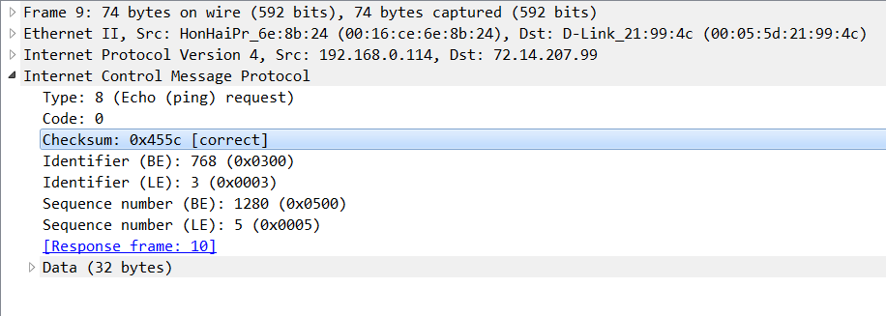
Ping example

Slide 70
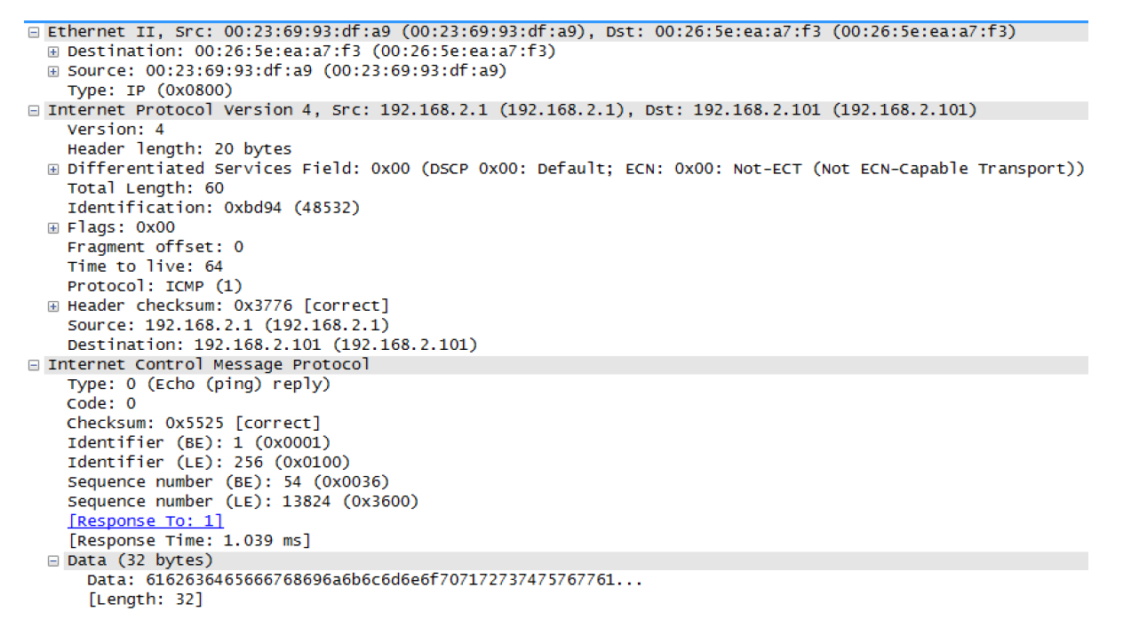
ICMP - Example (ping)

Slide 71
Traceroute
Traceroute records the route that packets take
A clever use of the TTL field
When a router receives a packet, it decrements TTL
If TTL=0, it sends an ICMP time exceeded message back to the sender
To determine the route, progressively increase TTL
Every time an ICMP time exceeded message is received, record the sender’s (router’s) address
Repeat until the destination host is reached or an error message occurs

Slide 72
Traceroute and ICMP
source sends series of UDP segments to dest
first set has TTL =1
second set has TTL=2, etc.
unlikely port number
when nth set of datagrams arrives to nth router:
router discards datagrams
and sends source ICMP messages (type 11, code 0)
ICMP messages includes name of router & IP address
when ICMP messages arrives, source records RTTs
stopping criteria:
UDP segment eventually arrives at destination host
destination returns ICMP “port unreachable” message (type 3, code 3)
source stops
3 probes
3 probes
3 probes

Slide 73
Traceroute (cont’d)
Te = Time exceeded
Pu = Port unreachable
A
R1
R2
R3
B
TTL=1, Dest = B,
port = invalid
Te (R1)
TTL=2, Dest = B
Time
Te (R2)
TTL=3, Dest = B
Te (R3)
TTL=4, Dest = B
Pu (B)

Slide 74
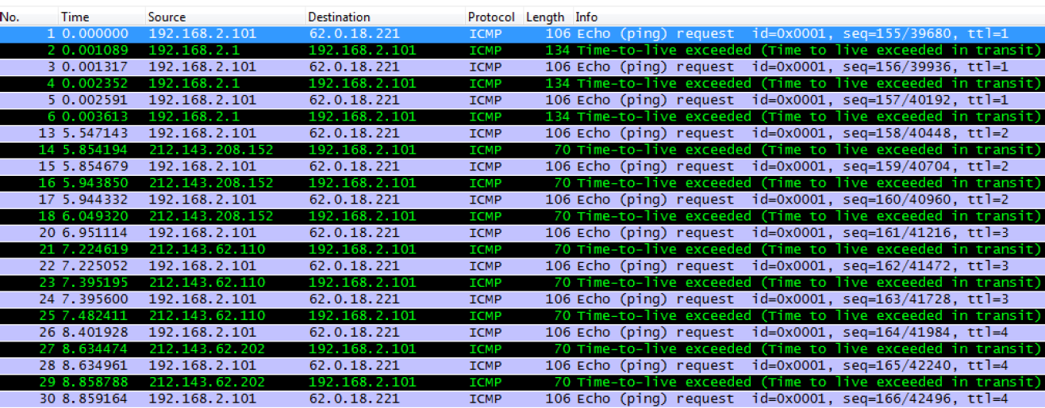

Slide 75
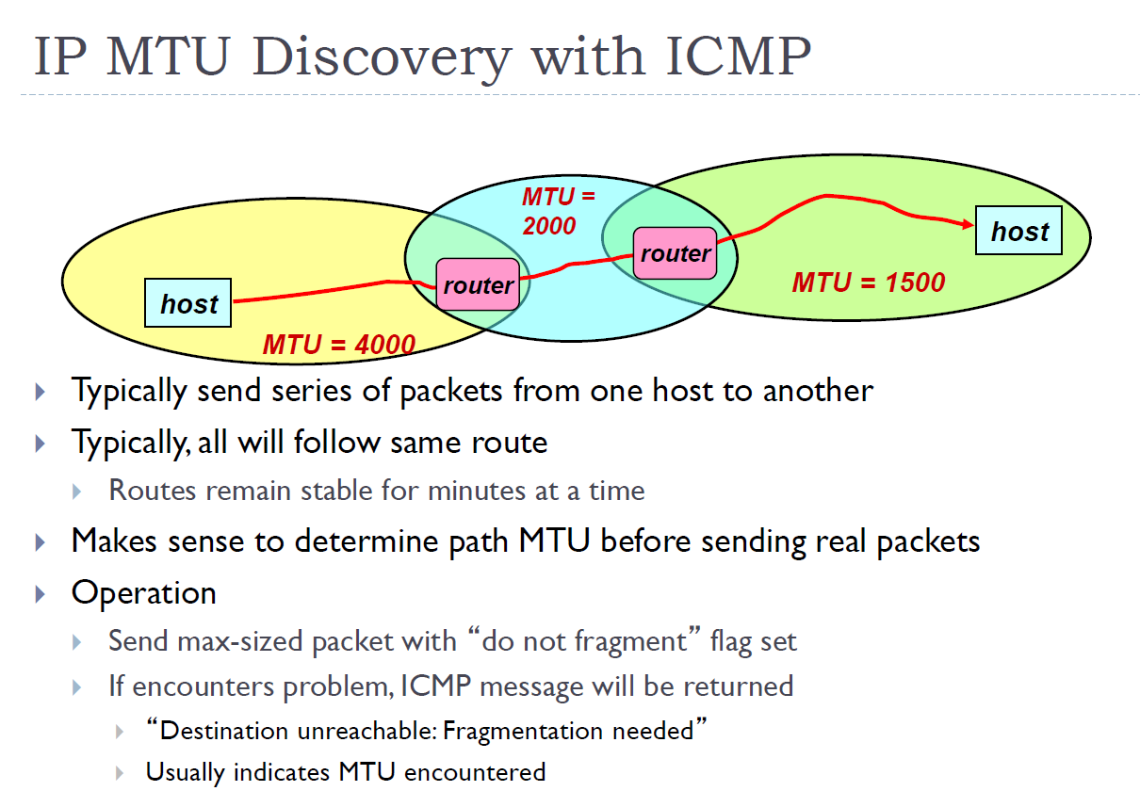

Slide 76
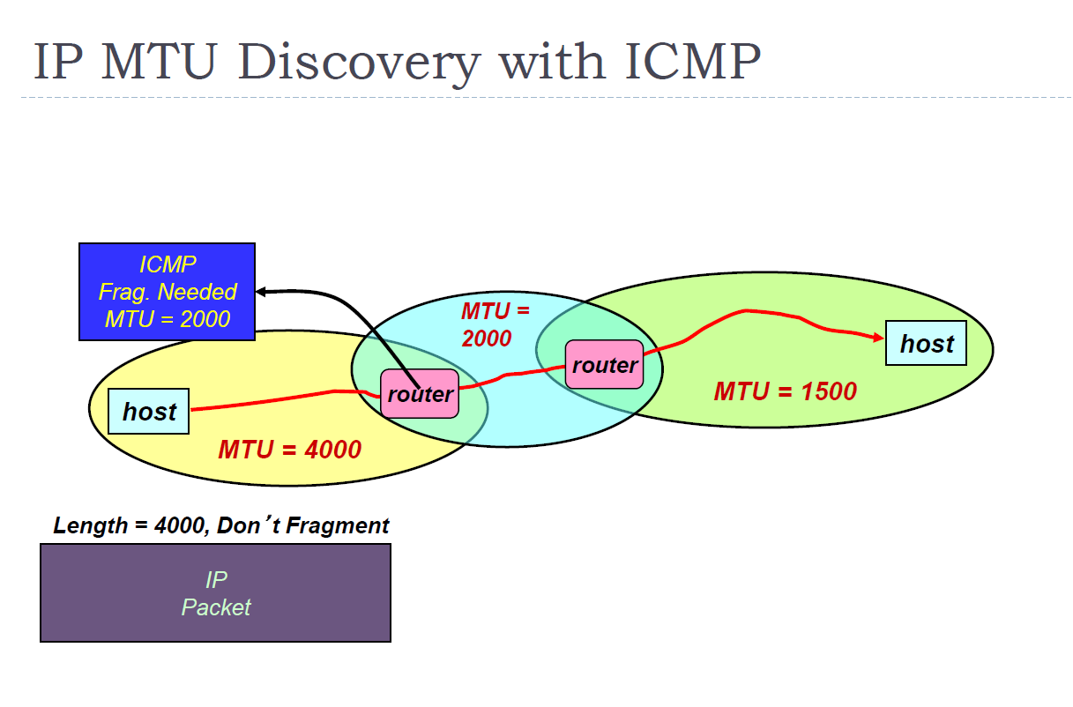

Slide 77
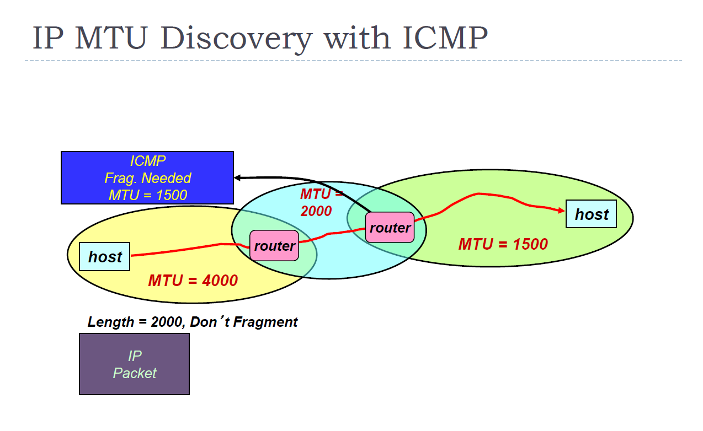

Slide 78
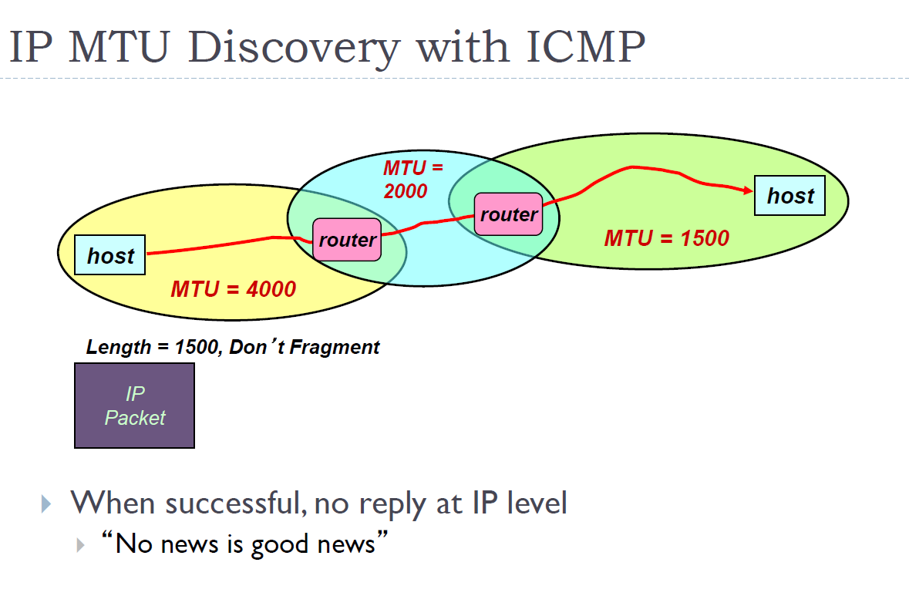

Slide 79
NAT

Slide 80
Private Network Accessing Public Internet
Don’t have enough IP addresses for every host in organization
Security
Don’t want every machine in organization known to outside world
Want to control or monitor traffic in / out of organization
W: Workstation
S: Server Machine
W
S
Corporation X
NAT
Internet
W
W

Slide 81
Reducing IP Addresses
Most machines within organization are used by individuals
“Workstations”
For most applications, act as clients
Small number of machines act as servers for entire organization
E.g., mail server
All traffic to outside passes through firewall
W: Workstation
S: Server Machine
W
S
Corporation X
NAT
Internet
W
W
(Most) machines within organization don’t need actual IP addresses!

Slide 82
NAT: network address translation
rest of
Internet
local network
(e.g., home network)
10.0.0/24
10.0.0.1
10.0.0.4
10.0.0.2
138.76.29.7
10.0.0.3
all datagrams leaving local
network have same single source NAT IP address: 138.76.29.7,different source port numbers
datagrams with source or
destination in this network
have 10.0.0/24 address for
source, destination (as usual)

Slide 83
NAT: Network Address Translation
Motivation: local network uses just one IP address as far as outside world is concerned:
Range of addresses not needed from ISP: just one IP address for all devices
Can change addresses of devices in local network without notifying outside world
Can change ISP without changing addresses of devices in local network
Devices inside local net not explicitly addressable, visible by outside world (a security plus).

Slide 84
NAT: Network Address Translation
Implementation: NAT router must:
outgoing datagrams: replace (source IP address, port #) of every outgoing datagram to (NAT IP address, new port #)
. . . remote clients/servers will respond using (NAT IP address, new port #) as destination addr.
remember (in NAT translation table) every (source IP address, port #) to (NAT IP address, new port #) translation pair
incoming datagrams: replace (NAT IP address, new port #) in dest fields of every incoming datagram with corresponding (source IP address, port #) stored in NAT table

Slide 85
NAT: network address translation
NAT translation table
WAN side addr LAN side addr
2: NAT router
changes datagram
source addr from
10.0.0.1, 3345 to
138.76.29.7, 5001,
updates table
1: host 10.0.0.1
sends datagram to
128.119.40.186, 80
138.76.29.7, 5001 10.0.0.1, 3345
…… ……
S: 10.0.0.1, 3345
D: 128.119.40.186, 80
10.0.0.1
1
2
S: 138.76.29.7, 5001
D: 128.119.40.186, 80
10.0.0.4
10.0.0.2
138.76.29.7
S: 128.119.40.186, 80
D: 10.0.0.1, 3345
4
S: 128.119.40.186, 80
D: 138.76.29.7, 5001
3
10.0.0.3
4: NAT router
changes datagram
dest addr from
138.76.29.7, 5001 to 10.0.0.1, 3345
3: reply arrives
dest. address:
138.76.29.7, 5001

Slide 86
NAT traversal problem
client wants to connect to server with address 10.0.0.1
server address 10.0.0.1 local to LAN (client can’t use it as destination addr)
only one externally visible NATed address: 138.76.29.7
solution1: statically configure NAT to forward incoming connection requests at given port to server
e.g., (123.76.29.7, port 2500) always forwarded to 10.0.0.1 port 25000
10.0.0.1
client
?
10.0.0.4
138.76.29.7
NAT
router

Slide 87
NAT traversal problem
Solution 2: Universal Plug and Play (UPnP) Internet Gateway Device (IGD) Protocol. Allows NATed host to:
learn public IP address (138.76.29.7)
add/remove port mappings (with lease times)
i.e., automate static NAT port map configuration
10.0.0.1
IGD
NAT
router

Slide 88



NAT traversal problem
solution 3: relaying (used in Skype)
NATed client establishes connection to relay
external client connects to relay
relay bridges packets between to connections
2. connection to
relay initiated
by client
1. connection to
relay initiated
by NATed host
10.0.0.1
client
3. relaying
established
138.76.29.7
NAT
router
Notes:
להדגיש שנתב NAT מבצע חיבור של חבילות במצב של fregmentation
זה עקב כך שברוב מקרים ה-data שמכיל את ה-transport header נמצא בתת סגמנט הראשון ולכן צריך לאחד שם

Slide 89
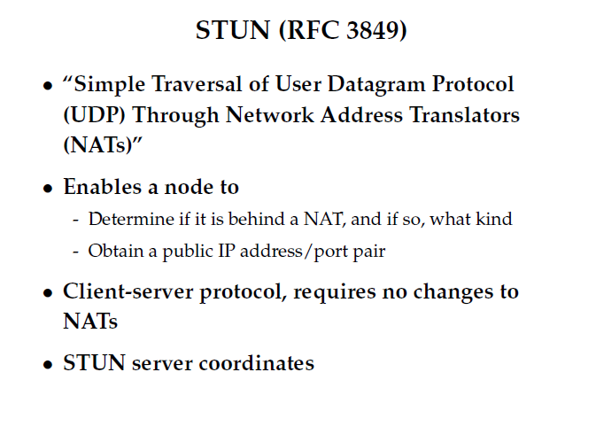
Notes:
יש פה טעות במספר זה 3489
Full Cone: A full cone NAT is one where all requests from the same internal IP address and port are mapped to the same external IP address and port. Furthermore, any external host can send a packet to the internal host, by sending a packet to the mapped external address.
Restricted Cone: A restricted cone NAT is one where all requests from the same internal IP address and port are mapped to the same external IP address and port. Unlike a full cone NAT, an external host (with IP address X) can send a packet to the internal host only if the internal host had previously sent a packet to IP address X.
Port Restricted Cone: A port restricted cone NAT is like a restricted cone NAT, but the restriction includes port numbers. Specifically, an external host can send a packet, with source IP address X and source port P, to the internal host only if the internal host had previously sent a packet to IP address X and port P.
Symmetric: A symmetric NAT is one where all requests from the same internal IP address and port, to a specific destination IP address and port, are mapped to the same external IP address and port. If the same host sends a packet with the same source address and port, but to a different destination, a different mapping is used. Furthermore, only the external host that receives a packet can send a UDP packet back to the internal host.

Slide 90
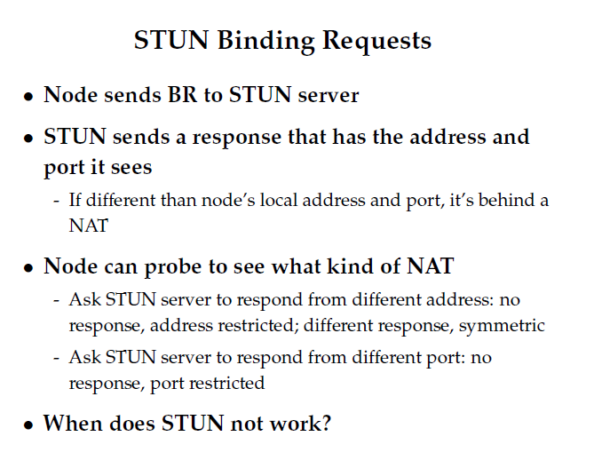

Slide 91
NAT Considerations
NAT has to be consistent during a session.
Set up mapping at the beginning of a session and maintain it during the session
Recall 2nd level goal 1 of Internet: Continue despite loss of networks or gateways
What happens if your NAT reboots?
Recycle the mapping that the end of the session
May be hard to detect
NAT only works for certain applications.
Some applications (e.g. ftp) pass IP information in payload
Need application level gateways to do a matching translation
Breaks a lot of applications.
Example: Let’s look at FTP
NAT is loved and hated
- Breaks many apps (FTP)
- Inhibits deployment of new applications like p2p (but so do firewalls!)
+ Little NAT boxes make home networking simple.
+ Saves addresses. Makes allocation simple.

Slide 92
IPv6

Slide 93
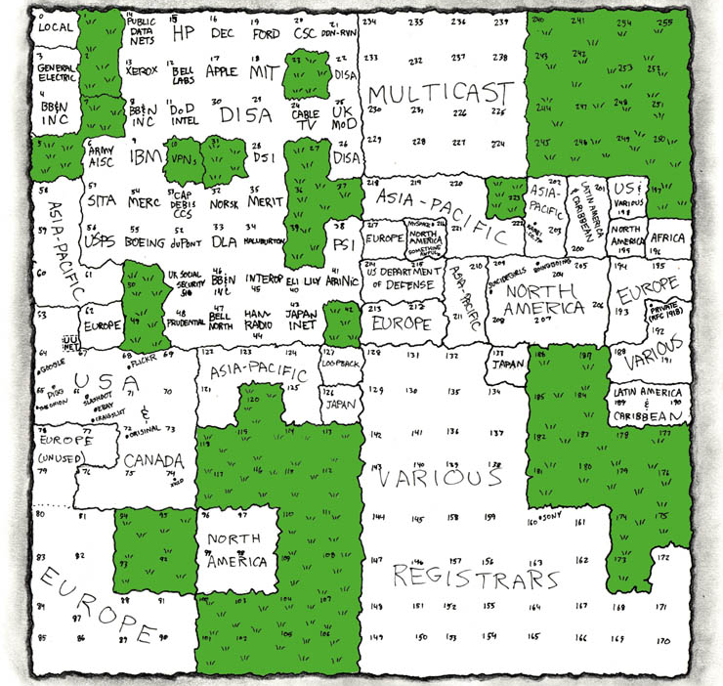
IP Address Utilization (‘06)
http://xkcd.com/195/

Slide 94
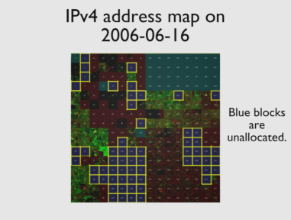
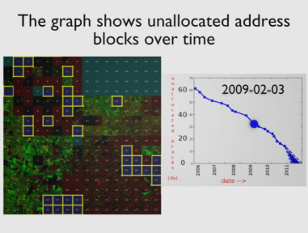
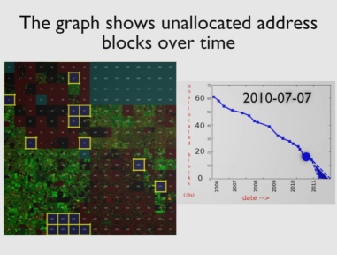

Slide 95

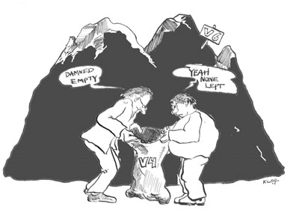
What Now?

Slide 96
IPv6: motivation
initial motivation: 32-bit address space soon to be completely allocated.
additional motivation:
header format helps speed processing/forwarding
header changes to facilitate QoS
IPv6 datagram format:
fixed-length 40 byte header
no fragmentation allowed

Slide 97
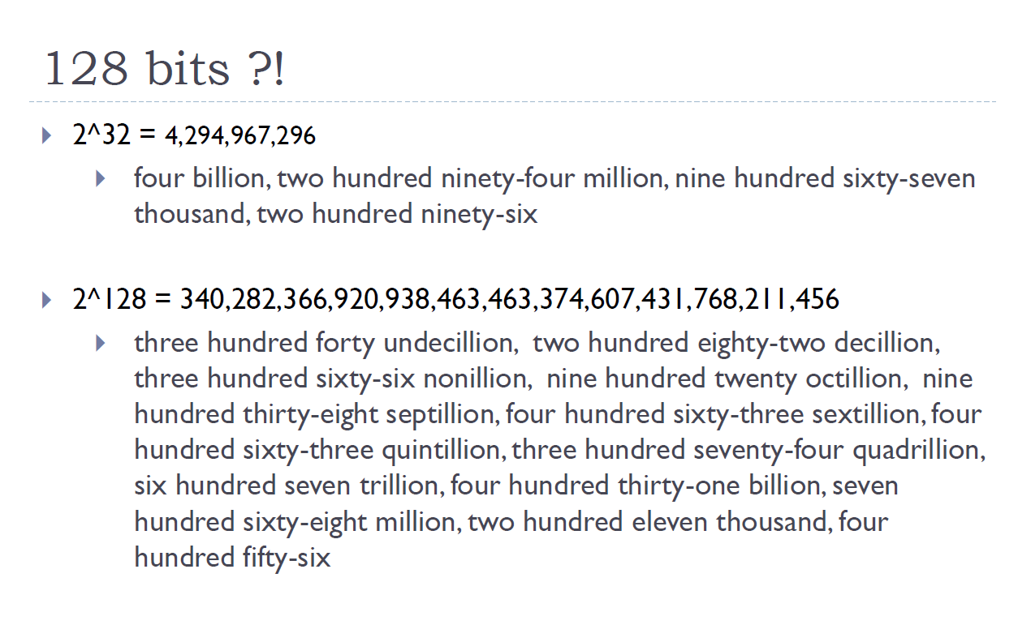

Slide 98
IPv6 datagram format
priority: identify priority among datagrams in flow
flow Label: identify datagrams in same “flow.”
(concept of“flow” not well defined).
next header: identify upper layer protocol for data
ver
pri
flow label
payload len
next hdr
hop limit
source address
(128 bits)
destination address
(128 bits)
data
32 bits

Slide 99
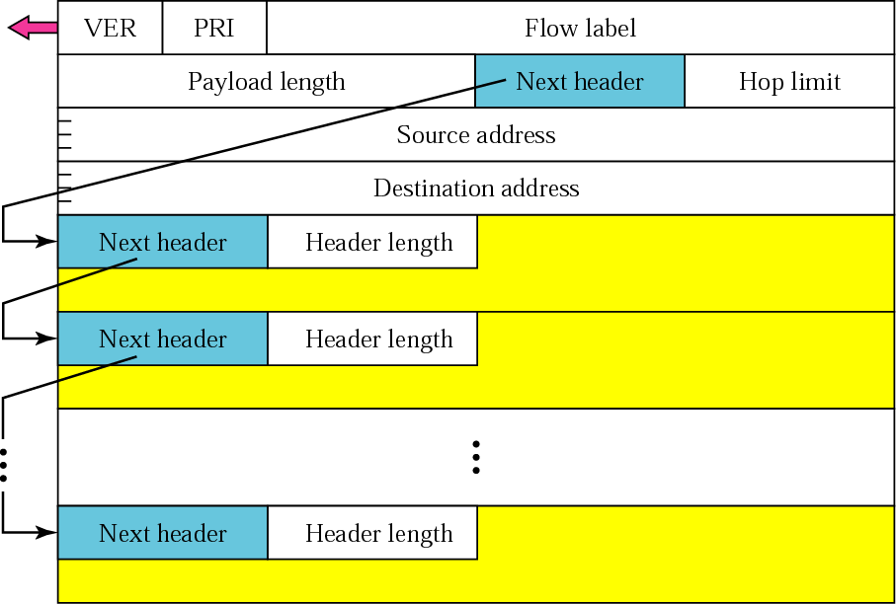
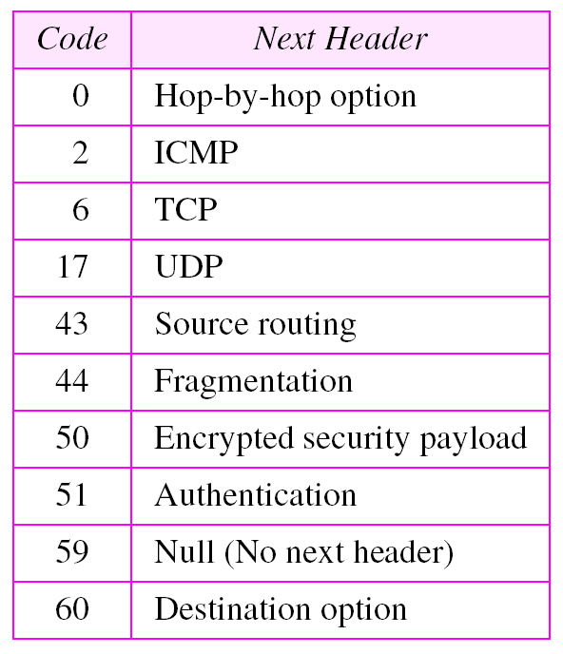
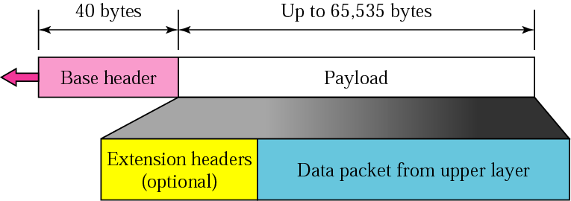
Next header

Slide 100
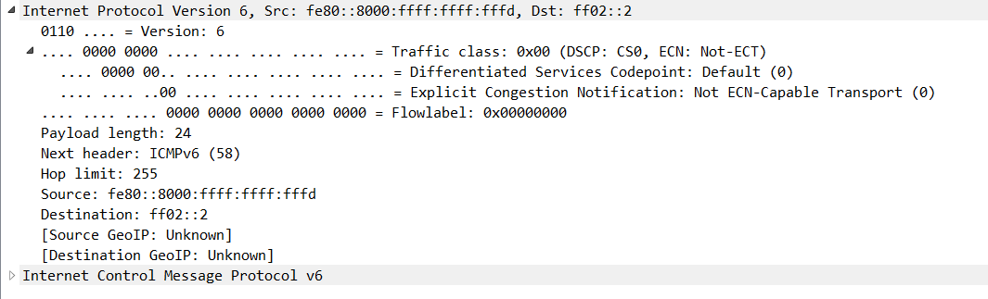

Slide 101
IPv6 Header Cleanup
Different options handling
IPv4 options: Variable length header field. 32 different options.
Rarely used
No development / many hosts/routers do not support
Worse than useless: Packets w/options often even get dropped!
Processed in “slow path”.
IPv6 options: “Next header” pointer
Combines “protocol” and “options” handling
Next header: “TCP”, “UDP”, etc.
Extensions header: Chained together
Makes it easy to implement host-based options
One value “hop-by-hop” examined by intermediate routers
Things like “source route” implemented only at intermediate hops

Slide 102
IPv6 Header Cleanup
No checksum
Why checksum just the IP header?
Efficiency: If packet corrupted at hop 1, don’t waste b/w transmitting on hops 2..N.
Useful when corruption frequent, b/w expensive
Today: Corruption rare, b/w cheap

Slide 103
IPv6 Fragmentation Cleanup
IPv4:
IPv6:
Discard packets, send ICMP “Packet Too Big”
Similar to IPv4 “Don’t Fragment” bit handling
Sender must support Path MTU discovery
Receive “Packet too Big” messages and send smaller packets
Increased minimum packet size
Link must support 1280 bytes;
1500 bytes if link supports variable sizes
Reduced packet processing and network complexity.
Increased MTU a boon to application writers
Hosts can still fragment - using fragmentation header. Routers don’t deal with it any more.
Large MTU
Small MTU
Router must fragment

Slide 104
Transition from IPv4 to IPv6
not all routers can be upgraded simultaneously
no “flag days”
how will network operate with mixed IPv4 and IPv6 routers?
tunneling: IPv6 datagram carried as payload in IPv4 datagram among IPv4 routers
IPv4 header fields
IPv6 header fields
IPv4 payload
IPv4 source, dest addr
IPv6 source dest addr
UDP/TCP payload
IPv6 datagram
IPv4 datagram

Slide 105
Tunneling
A
B
IPv4 tunnel
connecting IPv6 routers
E
F
logical view:
IPv6
IPv6
IPv6
IPv6
A
B
C
D
E
F
physical view:
IPv6
IPv6
IPv4
IPv4
IPv6
IPv6

Slide 106
Tunneling
A
B
IPv4 tunnel
connecting IPv6 routers
E
F
logical view:
IPv6
IPv6
IPv6
IPv6
A
B
C
D
E
F
physical view:
IPv6
IPv6
IPv4
IPv4
IPv6
IPv6
flow: X
src: A
dest: F
data
src:B
dest: E
src:B
dest: E
flow: X
src: A
dest: F
data
Flow: X
Src: A
Dest: F
data
Flow: X
Src: A
Dest: F
data
A-to-B:
IPv6
B-to-C:
IPv6 inside
IPv4
B-to-C:
IPv6 inside
IPv4
E-to-F:
IPv6

Slide 107
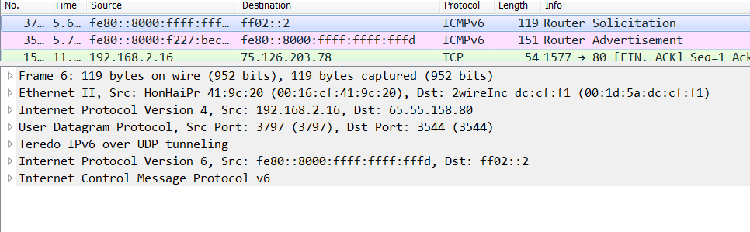

Slide 108
Important Concepts
Base-level protocol (IP) provides minimal service level
Allows highly decentralized implementation
Each step involves determining next hop
Most of the work at the endpoints
ICMP provides low-level error reporting
IP forwarding → global addressing, alternatives, lookup tables
IP addressing → hierarchical, CIDR
IP service → best effort, simplicity of routers
IP packets → header fields, fragmentation, ICMP

Slide 109
6to4 Basics
Problem: you’ve been assigned an IPv4 address, but you want an IPv6 address
Your ISP can’t or won’t give you an IPv6 address
You can’t just arbitrarily choose an IPv6 address
Solution: construct a 6to4 address
6to4 addresses always start with 2002::
Embed the 32-bit IPv4 inside the 128-bit IPv6 address
IPv4:
207.
46.
192.
0
IPv6:
20 02:
CF 2E:
C0 00:
0000

Slide 110

Routing from 6to4 to 6to4
How does a host using 6to4 send a packet to another host using 6to4?
Dest: 16.79.8.0
Dest: 2002:104F:0800::
IPv4
Internet
IPv4 – 207.46.192.0
IPv6 – 2002:CF2E:C000::
IPv4 – 16.79.8.0
IPv6 – 2002:104F:0800::

Slide 111

Routing from 6to4 to Native IPv6
Special, anycasted IPv4 address for
6to4 Relay Routers
Dest: 192. 88.99.1
Dest: 1893:92:13:99::
IPv4
Internet
IPv4 – 192.88.99.1
IPv6 – 2002:: /16
IPv4 – 207.46.192.0
IPv6 – 2002:CF2E:C000::
IPv6
Internet
Many ISPs provide 6to4 relay routers
IPv6 – 1893:92:13:99::

Slide 112
Routing from Native IPv6 to 6to4
IPv4
Internet
Dest: 207.46.192.0
IPv4 – 192.88.99.1
IPv6 – 2002:: /16
IPv4 – 207.46.192.0
IPv6 – 2002:CF2E:C000::
IPv6
Internet
Dest: 2002:CF2E:C000::
Use normal IPv6 routing to reach a 6to4 relay router
IPv6 – 1893:92:13:99::

Slide 113
IPv6 Scope and Multicasting
IPv6 128-bit space is spitted to 64-bit network part and 64-bit host part.
IANA allocates 48-bit networks leaving 64-48 = 16 bit for local subnetting.
IPv6 Address Scope: local, global, etc. scope.
Local scope address – an automatically generated LAN-only valid IPv6 address based on MAC.
There are 8 scopes for multi-casting addresses:
- No formal broadcasting - instead a local network scope
multi-casting.
- Major improvements of multi-casting. Hopefully, it will
be supported broadly and IP (IPv6) multicasting to
become a reality.

Slide 114
Problems with 6to4
Uniformity
Not all ISPs have deployed 6to4 relays
Quality of service
Third-party 6to4 relays are available
…but, they may be overloaded or unreliable
Reachability
6to4 doesn’t work if you are behind a NAT
Possible solutions
IPv6 Rapid Deployment (6rd)
Each ISP sets up relays for its customers
Does not leverage the 2002:: address space
Teredo
Tunnels IPv6 packets through UDP/IPv4 tunnels
Can tunnel through NATs, but requires special relays

Slide 115
Consequences of IPv6
Beware unintended consequences of IPv6
Example: IP blacklists
Currently, blacklists track IPs of spammers/bots
Few IPv4 addresses mean list sizes are reasonable
Hard for spammers/bots to acquire new IPs
Blacklists will not work with IPv6
Address space is enormous
Acquiring new IP addresses is trivial
Notes:
יאללה kahoot

Slide 116
Routing Algorithms
Notes:
אריאל בוקר/ערב

Slide 117
IP Forwarding
The Story So Far…
IP addresses are structured to reflect Internet structure
IP packet headers carry these addresses
When Packet Arrives at Router
Examine header to determine intended destination
Look up in table to determine next hop in path
Send packet out appropriate port
How to generate the forwarding table
Router

Slide 118
Interplay between routing, forwarding
routing algorithm determines
end-end-path through network
routing algorithm
forwarding table determines
local forwarding at this router
local forwarding table
dest address
output link
address-range 1
address-range 2
address-range 3
address-range 4
3
2
2
1
IP destination address in
arriving packet’s header
1
3
2

Slide 119
Graph Model
Represent each router as node
Direct link between routers represented by edge
Symmetric links ⇒ undirected graph
Edge “cost” c(x,y) denotes measure of difficulty of using link
delay, $ cost, or congestion level
Task
Determine least cost path from every node to every other node
Path cost d(x,y) = sum of link costs
E
C
3
1
F
1
2
6
1
3
D
A
4
B

Slide 120
Routes from Node A
Properties
Some set of shortest paths forms tree
Shortest path spanning tree
Solution not unique
E.g., A-E-F-C-D also has cost 7
Forwarding Table for A
Dest | Cost | Next Hop
A | 0 | A
B | 4 | B
C | 6 | E
D | 7 | B
E | 2 | E
F | 5 | E
E
C
3
1
F
1
2
6
1
3
D
A
4
B

Slide 121
Ways to Compute Shortest Paths
Centralized
Collect graph structure in one place
Use standard graph algorithm
Disseminate routing tables
Link-state
Every node collects complete graph structure
Each computes shortest paths from it
Each generates own routing table
Distance-vector
No one has copy of graph
Nodes construct their own tables iteratively
Each sends information about its table to neighbors

Slide 122
Link State

Slide 123
A Link-State Routing Algorithm
Dijkstra’s algorithm
net topology, link costs known to all nodes
accomplished via “link state broadcast”
all nodes have same info
computes least cost paths from one node (‘source”) to all other nodes
gives forwarding table for that node
iterative: after k iterations, know least cost path to k dest.’s
notation:
c(x,y): link cost from node x to y; = ∞ if not direct neighbors
D(v): current value of cost of path from source to dest. v
p(v): predecessor node along path from source to v
N': set of nodes whose least cost path definitively known

Slide 124
Dijsktra’s Algorithm
1 Initialization:
2 N' = {u}
3 for all nodes v
4 if v adjacent to u
5 then D(v) = c(u,v)
6 else D(v) = ∞
7
8 Loop
9 find w not in N' such that D(w) is a minimum
10 add w to N'
11 update D(v) for all v adjacent to w and not in N' :
12 D(v) = min( D(v), D(w) + c(w,v) )
13 /* new cost to v is either old cost to v or known
14 shortest path cost to w plus cost from w to v */
15 until all nodes in N'

Slide 125
Dijkstra’s algorithm: example
D(v)
p(v)
D(w)
p(w)
D(x)
p(x)
D(y)
p(y)
D(z)
p(z)
Step
N'
0
u
7,u
3,u
5,u
∞
∞
1
uw
6,w
5,u
11,w
∞
2
uwx
6,w
11,w
14,x
3
uwxv
10,v
14,x
x
4
uwxvy
12,y
9
5
uwxvyz
7
5
4
notes:
construct shortest path tree by tracing predecessor nodes
ties can exist (can be broken arbitrarily)
8
u
3
w
y
z
2
3
7
4
v

Slide 126
Dijkstra’s Algorithm: Concept
E
C
∞
2
3
5
1
Current Path Costs
F
2
2
6
Source
Node
0
1
∞
3
3
D
A
3
B
Done
Unseen
Horizon
Node Sets
Done
Already have least cost path to it
Horizon:
Reachable in 1 hop from node in Done
Unseen:
Cannot reach directly from node in Done
Label
d(v) = path cost from s to v
Path
Keep track of last link in path

Slide 127
Dijkstra’s Algorithm: Initially
E
C
∞
∞
3
∞
1
Current Path Costs
F
2
2
6
Source
Node
0
1
∞
∞
3
D
A
3
Horizon
B
Done
Unseen
No nodes done
Source in horizon

Slide 128
Dijkstra’s Algorithm: Initially
d(v) to node A shown in red
Only consider links from done nodes
E
C
∞
2
3
6
1
Current Path Costs
F
2
2
6
Source
Node
0
1
∞
3
3
D
A
3
B
Done
Horizon
Unseen

Slide 129
Dijkstra’s Algorithm
Select node v in horizon with minimum d(v)
Add link used to add node to shortest path tree
Update d(v) information
E
C
∞
2
3
5
6
1
Current Path Costs
F
2
2
6
Source
Node
0
1
∞
3
3
D
A
3
B
Done
Unseen
Horizon

Slide 130
Dijkstra’s Algorithm
Repeat…
E
Horizon
C
∞
2
3
5
1
Current Path Costs
F
2
2
6
Source
Node
0
1
∞
3
3
D
A
3
B
Done
Unseen

Slide 131
Dijkstra’s Algorithm
Update d(v) values
Can cause addition of new nodes to horizon
∞
Unseen
2
E
C
3
4
1
Current Path Costs
F
2
2
6
Source
Node
0
1
6
3
3
D
A
3
B
Horizon
Done

Slide 132
Dijkstra’s Algorithm
Final tree shown in green
E
C
5
2
3
4
1
F
2
2
6
Source
Node
0
1
6
3
3
D
A
3
B

Slide 133
Distance Vector

Slide 134
Distance vector algorithm
Bellman-Ford equation (dynamic programming)
let
d_{x}(y) := cost of least-cost path from x to y
then
d_{x}(y) = min {c(x,v) + d_{v}(y) }
v
cost from neighbor v to destination y
cost to neighbor v
min taken over all neighbors v of x

Slide 135
Bellman-Ford example
clearly, d_{v}(z) = 5, d_{x}(z) = 3, d_{w}(z) = 3
5
B-F equation says:
v
3
w
d_{u}(z) = min { c(u,v) + d_{v}(z),
c(u,x) + d_{x}(z),
c(u,w) + d_{w}(z) }
= min {2 + 5,
1 + 3,
5 + 3} = 4
2
5
u
2
1
z
3
1
2
x
y
1
node achieving minimum is next
hop in shortest path, used in forwarding table

Slide 136
Distance vector algorithm
D_{x}(y) = estimate of least cost from x to y
x maintains distance vector D_{x} = [D_{x}(y): y є N ]
node x:
knows cost to each neighbor v: c(x,v)
maintains its neighbors’ distance vectors. For each neighbor v, x maintains D_{v} = [D_{v}(y): y є N ]

Slide 137
Distance vector algorithm
key idea:
from time-to-time, each node sends its own distance vector estimate to neighbors
when x receives new DV estimate from neighbor, it updates its own DV using B-F equation:
under minor, natural conditions, the estimate D_{x}(y) converge to the actual least cost d_{x}(y)
D_{x}(y) ← min_{v}{c(x,v) + D_{v}(y)} for each node y ∊ N

Slide 138
Distance vector algorithm
iterative, asynchronous: each local iteration caused by:
local link cost change
DV update message from neighbor
distributed:
each node notifies neighbors only when its DV changes
neighbors then notify their neighbors if necessary
each node:
wait for (change in local link cost or msg from neighbor)
recompute estimates
if DV to any dest has changed, notify neighbors

Slide 139
Start
Optimum 1-hop paths
Table for A
Dst | Cst | Hop
A | 0 | A
B | 4 | B
C | ∞ | –
D | ∞ | –
E | 2 | E
F | 6 | F
Table for B
Dst | Cst | Hop
A | 4 | A
B | 0 | B
C | ∞ | –
D | 3 | D
E | ∞ | –
F | 1 | F
E
C
3
1
F
1
2
6
1
3
D
A
4
B
Table for C
Dst | Cst | Hop
A | ∞ | –
B | ∞ | –
C | 0 | C
D | 1 | D
E | ∞ | –
F | 1 | F
Table for D
Dst | Cst | Hop
A | ∞ | –
B | 3 | B
C | 1 | C
D | 0 | D
E | ∞ | –
F | ∞ | –
Table for E
Dst | Cst | Hop
A | 2 | A
B | ∞ | –
C | ∞ | –
D | ∞ | –
E | 0 | E
F | 3 | F
Table for F
Dst | Cst | Hop
A | 6 | A
B | 1 | B
C | 1 | C
D | ∞ | –
E | 3 | E
F | 0 | F

Slide 140
Iteration #1
Optimum 2-hop paths
Table for A
Dst | Cst | Hop
A | 0 | A
B | 4 | B
C | 7 | F
D | 7 | B
E | 2 | E
F | 5 | E
Table for B
Dst | Cst | Hop
A | 4 | A
B | 0 | B
C | 2 | F
D | 3 | D
E | 4 | F
F | 1 | F
E
C
3
1
F
1
2
6
1
3
D
A
4
B
Table for C
Dst | Cst | Hop
A | 7 | F
B | 2 | F
C | 0 | C
D | 1 | D
E | 4 | F
F | 1 | F
Table for D
Dst | Cst | Hop
A | 7 | B
B | 3 | B
C | 1 | C
D | 0 | D
E | ∞ | –
F | 2 | C
Table for E
Dst | Cst | Hop
A | 2 | A
B | 4 | F
C | 4 | F
D | ∞ | –
E | 0 | E
F | 3 | F
Table for F
Dst | Cst | Hop
A | 5 | B
B | 1 | B
C | 1 | C
D | 2 | C
E | 3 | E
F | 0 | F

Slide 141
Iteration #2
Optimum 3-hop paths
Table for A
Dst | Cst | Hop
A | 0 | A
B | 4 | B
C | 6 | E
D | 7 | B
E | 2 | E
F | 5 | E
Table for B
Dst | Cst | Hop
A | 4 | A
B | 0 | B
C | 2 | F
D | 3 | D
E | 4 | F
F | 1 | F
E
C
3
1
F
1
2
6
1
3
D
A
4
B
Table for C
Dst | Cst | Hop
A | 6 | F
B | 2 | F
C | 0 | C
D | 1 | D
E | 4 | F
F | 1 | F
Table for D
Dst | Cst | Hop
A | 7 | B
B | 3 | B
C | 1 | C
D | 0 | D
E | 5 | C
F | 2 | C
Table for E
Dst | Cst | Hop
A | 2 | A
B | 4 | F
C | 4 | F
D | 5 | F
E | 0 | E
F | 3 | F
Table for F
Dst | Cst | Hop
A | 5 | B
B | 1 | B
C | 1 | C
D | 2 | C
E | 3 | E
F | 0 | F

Slide 142
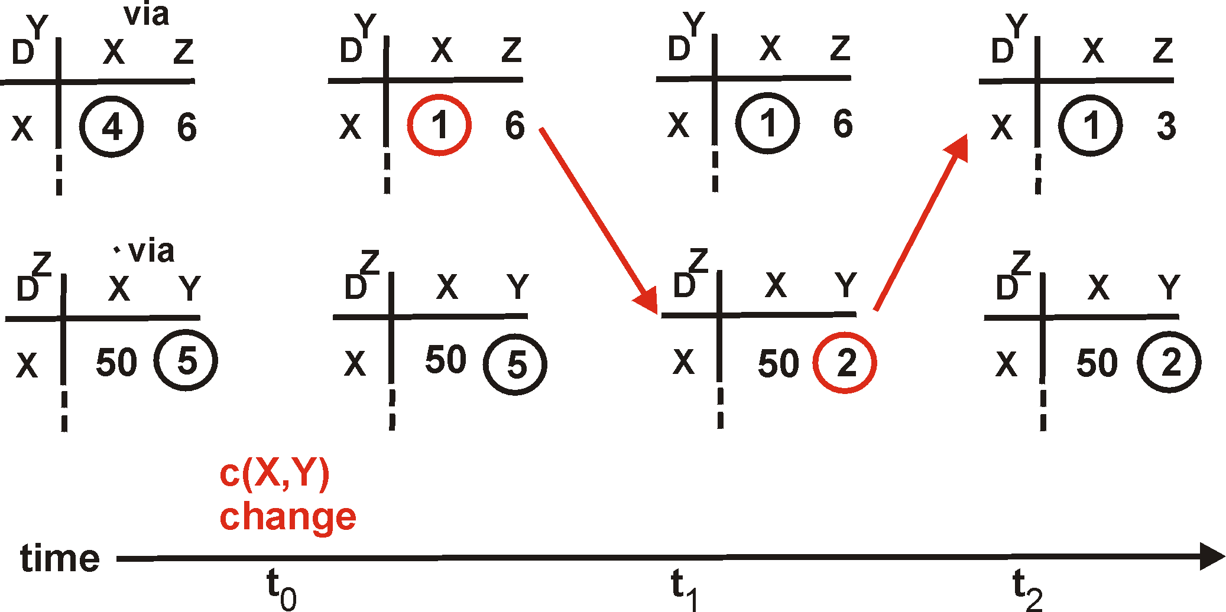
Distance Vector: Link Cost Changes
Link cost changes:
Node detects local link cost change
Updates distance table
If cost change in least cost path, notify neighbors
1
Y
4
1
X
Z
50
algorithm
terminates
“good
news
travels
fast”

Slide 143
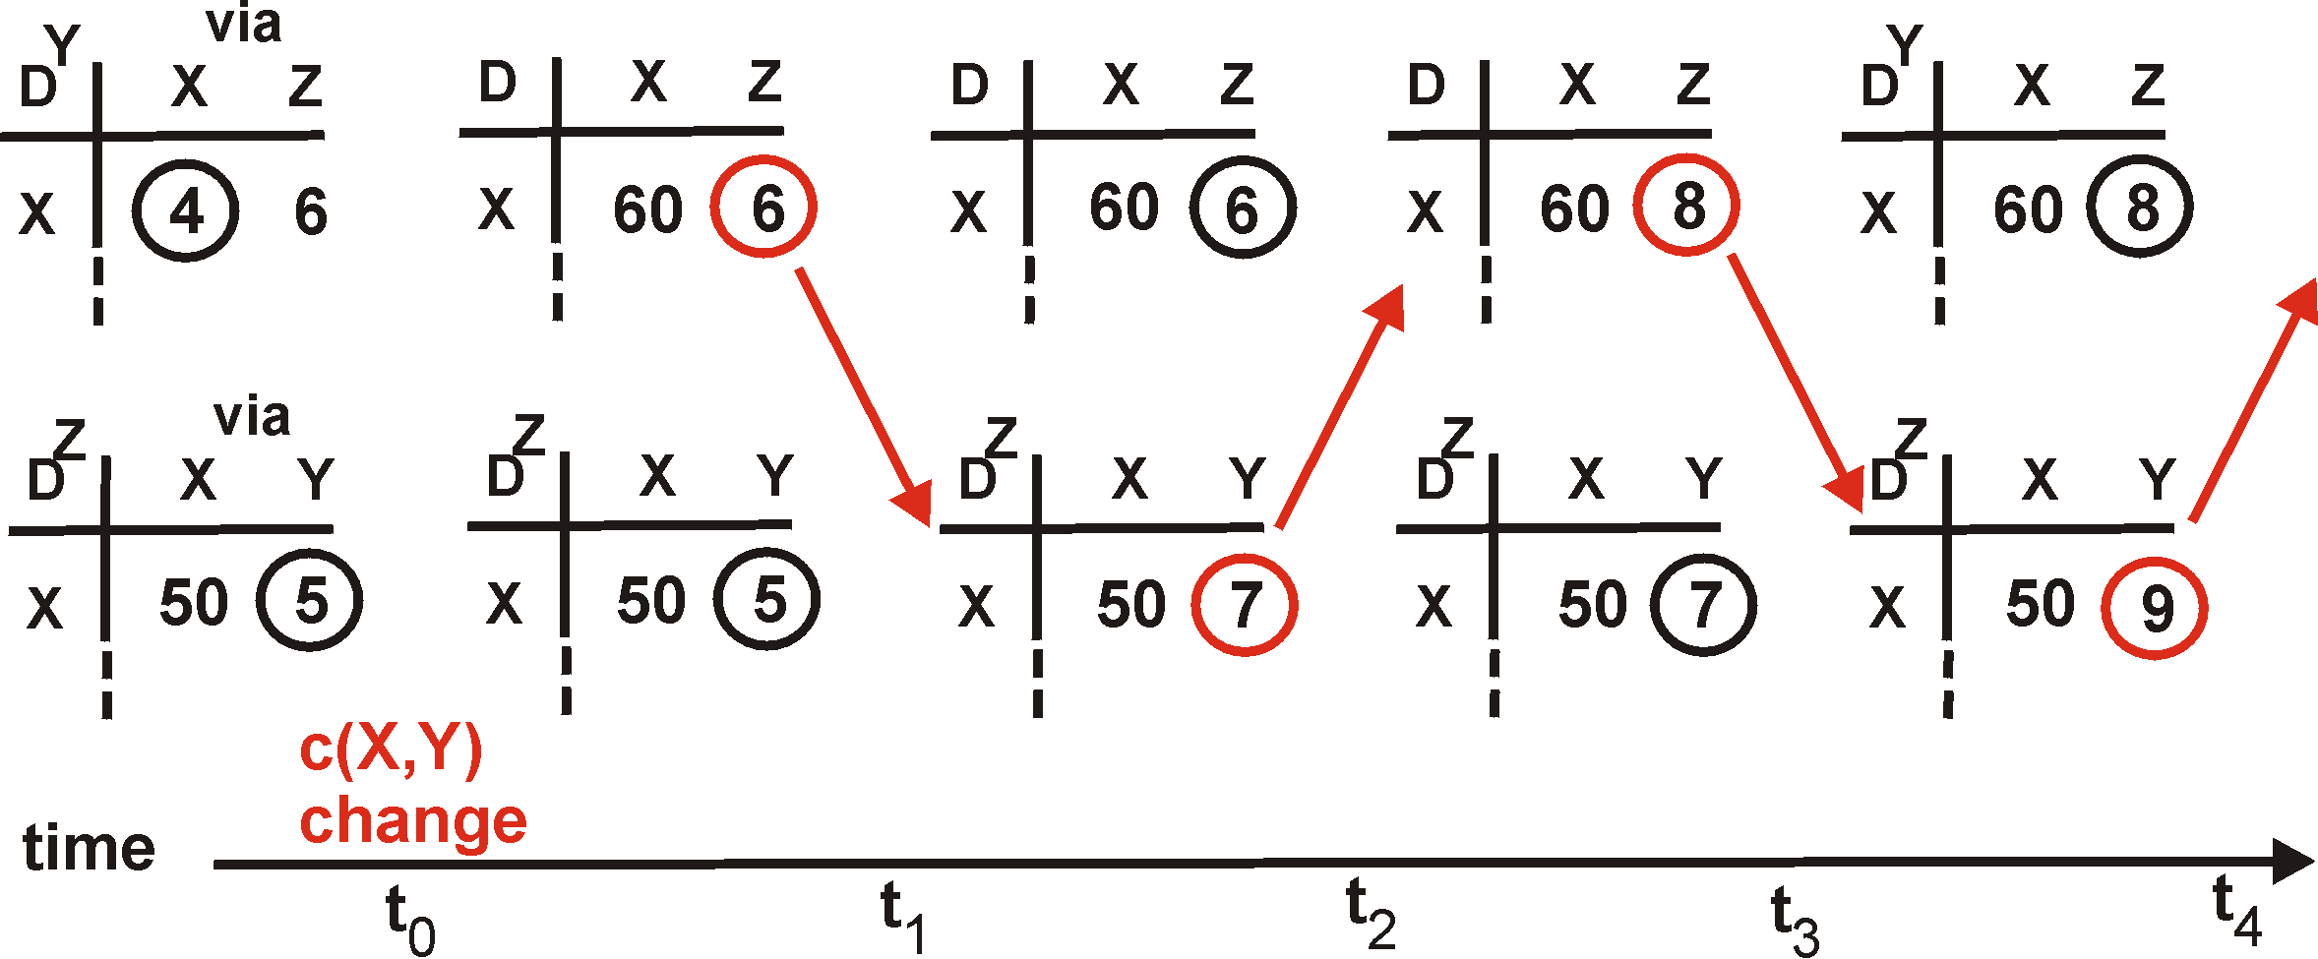
Distance Vector: Link Cost Changes
Link cost changes:
Good news travels fast
Bad news travels slow - “count to infinity” problem!
60
Y
4
1
X
Z
50
algorithm
continues
on!

Slide 144
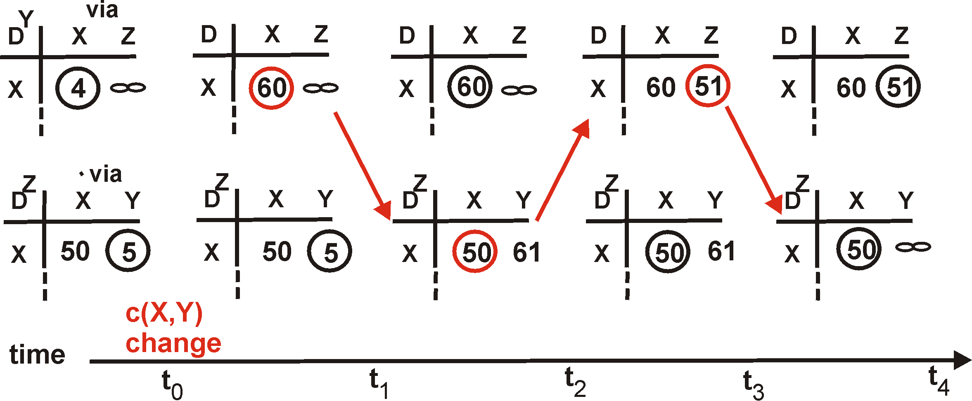
Distance Vector: Split Horizon
If Z routes through Y to get to X :
Z does not advertise its route to X back to Y
60
Y
4
1
X
Z
50
algorithm
terminates
?
?
?

Slide 145
Distance Vector: Poison Reverse
If Z routes through Y to get to X :
Z tells Y its (Z’s) distance to X is infinite (so Y won’t route to X via Z)
Immediate notification of unreachability, rather than split horizon timeout waiting for advertisement
Will this completely solve count to infinity problem?
60
Y
4
1
X
Z
50
algorithm
terminates

Slide 146
Comparison of LS and DV algorithms
robustness: what happens if router malfunctions?
LS:
node can advertise incorrect link cost
each node computes only its own table
DV:
DV node can advertise incorrect path cost
each node’s table used by others
error propagate thru network
message complexity
LS: with n nodes, E links, O(nE) msgs sent
DV: exchange between neighbors only
convergence time varies
speed of convergence
LS: O(n²) algorithm requires O(nE) msgs
may have oscillations
DV: convergence time varies
may be routing loops
count-to-infinity problem

Slide 147
Chapter 4: outline
4.1 introduction
4.2 virtual circuit and datagram networks
4.3 what’s inside a router
4.4 IP: Internet Protocol
datagram format
IPv4 addressing
ICMP
IPv6
4.5 routing algorithms
link state
distance vector
hierarchical routing
4.6 routing in the Internet
RIP
OSPF
BGP
4.7 broadcast and multicast routing

Slide 148
Intra-AS Routing
also known as interior gateway protocols (IGP)
most common intra-AS routing protocols:
RIP: Routing Information Protocol
OSPF: Open Shortest Path First
IGRP: Interior Gateway Routing Protocol (Cisco proprietary)

Slide 149

Interior Gateway Protocols (IGP)
most common Intra-AS routing protocols:
RIP: Routing Information Protocol
OSPF: Open Shortest Path First
IGRP: Interior Gateway Routing Protocol (Cisco proprietary)
EGP
IGP

Slide 150
RIP ( Routing Information Protocol)
included in BSD-UNIX distribution in 1982
distance vector algorithm
distance metric: # hops (max = 15 hops), each link has cost 1
DVs exchanged with neighbors every 30 sec in response message (aka advertisement)
each advertisement: list of up to 25 destination subnets (in IP addressing sense)
from router A to destination subnets:
u
v
subnet hops
u 1
v 2
w 2
x 3
y 3
z 2
A
B
w
x
z
C
D
y

Slide 151
RIP: example
z
w
x
y
A
D
B
C
routing table in router D
destination subnet next router # hops to dest
w A 2
y B 2
z B 7
x -- 1
…. …. ....

Slide 152
RIP: example
A-to-D advertisement
dest next hops
w - 1
x - 1
z C 4
…. … ...
z
w
x
y
A
D
B
C
routing table in router D
destination subnet next router # hops to dest
w A 2
y B 2
z B 7
x -- 1
…. …. ....
A
5

Slide 153
RIP table processing
RIP routing tables managed by application-level process called route-d (daemon)
advertisements sent in UDP packets, periodically repeated
routed
routed
transport
(UDP)
transprt
(UDP)
network forwarding
(IP) table
network
(IP)
forwarding
table
link
link
physical
physical

Slide 154


Slide 155
RIP Updates
Initial
When router first starts, asks for copy of table for every neighbor
Uses it to iteratively generate own table
Periodic
Every 30 seconds, router sends copy of its table to each neighbor
Neighbors use it to iteratively update their tables
Triggered
When every entry changes, send copy of entry to neighbors
Except for one causing update (split horizon rule)
Neighbors use it to update their tables

Slide 156
RIP Staleness / Oscillation Control
Small Infinity
Count to infinity doesn’t take very long
Route Timer
Every route has timeout limit of 180 seconds
Reached when haven’t received update from next hop for 6 periods
If not updated, set to infinity
Soft-state refresh → important concept!
Behavior
When router or link fails, can take minutes to stabilize
Notes:
Lots of subtlety to get good implementation (RFC 1058).

Slide 157
OSPF (Open Shortest Path First)
“open”: publicly available
uses link state algorithm
LS packet dissemination
topology map at each node
route computation using Dijkstra’s algorithm
OSPF advertisement carries one entry per neighbor
advertisements flooded to entire AS
carried in OSPF messages directly over IP (rather than TCP or UDP
IS-IS routing protocol: nearly identical to OSPF

Slide 158
OSPF “advanced” features (not in RIP)
security: all OSPF messages authenticated (to prevent malicious intrusion)
multiple same-cost paths allowed (only one path in RIP)
for each link, multiple cost metrics for different TOS (e.g., satellite link cost set “low” for best effort ToS; high for real time ToS)
integrated uni- and multicast support:
Multicast OSPF (MOSPF) uses same topology data base as OSPF
hierarchical OSPF in large domains.

Slide 159
Hierarchical OSPF
boundary router
backbone router
backbone
area
border
routers
area 3
internal
routers
area 1
area 2

Slide 160

OSPF Reliable Flooding

Slide 161
OSPF Flooding Operation
Node X Receives LSA from Node Y
With Sequence Number q
Looks for entry with same origin/link ID
Cases
No entry present
Add entry, propagate to all neighbors other than Y
Entry present with sequence number p < q
Update entry, propagate to all neighbors other than Y
Entry present with sequence number p > q
Send entry back to Y
To tell Y that it has out-of-date information
Entry present with sequence number p = q
Ignore it

Slide 162
Flooding Issues
When should it be performed
Periodically
When status of link changes
Detected by connected node
What happens when router goes down & back up
Sequence number reset to 0
Other routers may have entries with higher sequence numbers
Router will send out LSAs with number 0
Will get back LSAs with last valid sequence number p
Router sets sequence number to p+1 & resends

Slide 163

OSPF Hello Packet
Notes:
תרגיל מתוך הבחינות

Slide 164
Chapter 4: outline
4.1 introduction
4.2 virtual circuit and datagram networks
4.3 what’s inside a router
4.4 IP: Internet Protocol
datagram format
IPv4 addressing
ICMP
IPv6
4.5 routing algorithms
link state
distance vector
hierarchical routing
4.6 routing in the Internet
RIP
OSPF
BGP
4.7 broadcast and multicast routing

Slide 165
Hierarchical routing
scale: with 600 million destinations:
can’t store all dest’s in routing tables!
routing table exchange would swamp links!
administrative autonomy
internet = network of networks
each network admin may want to control routing in its own network
our routing study thus far - idealization
all routers identical
network “flat”
… not true in practice

Slide 166
Hierarchical routing
aggregate routers into regions, “autonomous systems” (AS)
routers in same AS run same routing protocol
“intra-AS” routing protocol
routers in different AS can run different intra-AS routing protocol
gateway router:
at “edge” of its own AS
has link to router in another AS

Slide 167
Areas
Divide network into areas
Areas can have nested sub-areas
Hierarchically address nodes in a network
Sequentially number top-level areas
Sub-areas of area are labeled relative to that area
Nodes are numbered relative to the smallest containing area

Slide 168
Area Hierarchy Addressing
1
2
2.1
2.2
1.1
2.2.2
1.2
2.2.1
1.2.1
1.2.2
3
3.1
3.2

Slide 169
Interconnected ASes
3c
3a
2c
3b
2a
AS3
2b
1c
AS2
1a
1b
1d
AS1
forwarding table configured by both intra- and inter-AS routing algorithm
intra-AS sets entries for internal dests
inter-AS & intra-AS sets entries for external dests
Intra-AS
Routing
algorithm
Inter-AS
Routing
algorithm
Forwarding
table

Slide 170
Inter-AS tasks
AS1 must:
learn which dests are reachable through AS2, which through AS3
propagate this reachability info to all routers in AS1
job of inter-AS routing!
suppose router in AS1 receives datagram destined outside of AS1:
router should forward packet to gateway router, but which one?
3c
3a
3b
AS3
2c
other
networks
1c
2a
other
networks
1a
2b
1b
AS2
AS1
1d

Slide 171
Example: setting forwarding table in router 1d
suppose AS1 learns (via inter-AS protocol) that subnet x reachable via AS3 (gateway 1c), but not via AS2
inter-AS protocol propagates reachability info to all internal routers
router 1d determines from intra-AS routing info that its interface I is on the least cost path to 1c
installs forwarding table entry (x,I)
…
x
3c
3a
3b
AS3
2c
other
networks
1c
2a
other
networks
1a
2b
1b
AS2
AS1
1d

Slide 172
Example: choosing among multiple ASes
now suppose AS1 learns from inter-AS protocol that subnet x is reachable from AS3 and from AS2.
to configure forwarding table, router 1d must determine which gateway it should forward packets towards for dest x
this is also job of inter-AS routing protocol!
…
x
3c
……
3a
3b
AS3
2c
other
networks
1c
2a
other
networks
1a
2b
1b
AS2
AS1
1d
?

Slide 173
Example: choosing among multiple ASes
now suppose AS1 learns from inter-AS protocol that subnet x is reachable from AS3 and from AS2.
to configure forwarding table, router 1d must determine towards which gateway it should forward packets for dest x
this is also job of inter-AS routing protocol!
hot potato routing: send packet towards closest of two routers.
use routing info
from intra-AS
protocol to determine
costs of least-cost
paths to each
of the gateways
determine from
forwarding table the
interface I that leads
to least-cost gateway.
Enter (x,I) in
forwarding table
learn from inter-AS
protocol that subnet
x is reachable via
multiple gateways
hot potato routing:
choose the gateway
that has the
smallest least cost

Slide 174


Slide 175
Internet inter-AS routing: BGP
BGP (Border Gateway Protocol): the de facto inter-domain routing protocol
“glue that holds the Internet together”
BGP provides each AS a means to:
eBGP: obtain subnet reachability information from neighboring ASs.
iBGP: propagate reachability information to all AS-internal routers.
determine “good” routes to other networks based on reachability information and policy.
allows subnet to advertise its existence to rest of Internet: “I am here”

Slide 176
BGP basics
BGP session: two BGP routers (“peers”) exchange BGP messages:
advertising paths to different destination network prefixes (“path vector” protocol)
exchanged over semi-permanent TCP connections
when AS3 advertises a prefix to AS1:
AS3 promises it will forward datagrams towards that prefix
AS3 can aggregate prefixes in its advertisement
3c
3a
BGP
message
3b
AS3
2c
other
networks
1c
2a
other
networks
1a
2b
1b
AS2
AS1
1d
Notes:
אוניברסיטה מסלול בוקר

Slide 177
BGP basics: distributing path information
using eBGP session between 3a and 1c, AS3 sends prefix reachability info to AS1.
1c can then use iBGP do distribute new prefix info to all routers in AS1
1b can then re-advertise new reachability info to AS2 over 1b-to-2a eBGP session
when router learns of new prefix, it creates entry for prefix in its forwarding table.
eBGP session
3a
3b
iBGP session
AS3
2c
other
networks
1c
2a
other
networks
1a
2b
1b
AS2
AS1
1d

Slide 178
Path attributes and BGP routes
advertised prefix includes BGP attributes
prefix + attributes = “route”
two important attributes:
AS-PATH: contains ASs through which prefix advertisement has passed: e.g., AS 67, AS 17
NEXT-HOP: indicates specific internal-AS router to next-hop AS. (may be multiple links from current AS to next-hop-AS)
gateway router receiving route advertisement uses import policy to accept/decline
e.g., never route through AS x
policy-based routing

Slide 179
BGP route selection
router may learn about more than 1 route to destination AS, selects route based on:
local preference value attribute: policy decision
shortest AS-PATH
closest NEXT-HOP router: hot potato routing
additional criteria

Slide 180
BGP messages
BGP messages exchanged between peers over TCP connection
BGP messages:
OPEN: opens TCP connection to peer and authenticates sender
UPDATE: advertises new path (or withdraws old)
KEEPALIVE: keeps connection alive in absence of UPDATES; also ACKs OPEN request
NOTIFICATION: reports errors in previous msg; also used to close connection

Slide 181
BGP routing policy
legend:
provider
B
network
X
W
A
customer
C
network:
Y
A,B,C are provider networks
X,W,Y are customer (of provider networks)
X is dual-homed: attached to two networks
X does not want to route from B via X to C
.. so X will not advertise to B a route to C

Slide 182
BGP routing policy (2)
legend:
provider
B
network
X
W
A
customer
C
network:
Y
A advertises path AW to B
B advertises path BAW to X
Should B advertise path BAW to C?
No way! B gets no “revenue” for routing CBAW since neither W nor C are B’s customers
B wants to force C to route to w via A
B wants to route only to/from its customers!

Slide 183
Why different Intra-, Inter-AS routing ?
policy:
inter-AS: admin wants control over how its traffic routed, who routes through its net.
intra-AS: single admin, so no policy decisions needed
scale:
hierarchical routing saves table size, reduced update traffic
performance:
intra-AS: can focus on performance
inter-AS: policy may dominate over performance

Slide 184
BGP Operations (Simplified)
Establish session on
TCP port 179
AS1
BGP session
Exchange all
active routes
AS2
While connection
is ALIVE exchange
route UPDATE messages
Exchange incremental
updates

Slide 185
Two Types of BGP Neighbor Relationships
External Neighbor (eBGP) in a different Autonomous Systems
Internal Neighbor (iBGP) in the same Autonomous System
AS1
iBGP is routed (using IGP!)
eBGP
iBGP
AS2

Slide 186
AS-Path Attribute
AS 200
AS 100
170.10.0.0/16
180.10.0.0/16
Network Path
180.10.0.0/16 300 200 100
170.10.0.0/16 300 200
AS 300
AS 400
150.10.0.0/16
Network Path
180.10.0.0/16 300 200 100
170.10.0.0/16 300 200
150.10.0.0/16 300 400
AS 500
Sequence of ASes a route has traversed
Loop detection
Discard updates containing your own AS number
Apply policy

Slide 187
Customers Don’t Always Need BGP
provider
Configured route 192.0.2.0/24
pointing to customer
Default route 0.0.0.0/0
pointing to provider.
customer
192.0.2.0/24
Static routing is the most common way of connecting an
autonomous routing domain to the Internet.
So many net-admin don’t use/know BGP …

Slide 188
Customer-Provider Hierarchy
provider
customer
IP traffic

Slide 189
סרטון של כותבי הסרט
Notes:
https://media.pearsoncmg.com/aw/ecs_kurose_compnetwork_7/cw/videonotes-cw.php

Slide 190
לינקים חשובים
https://www.youtube.com/watch?v=z8INzy9E628 – להראות בכיתה
https://www.youtube.com/watch?v=ZTJIkjgyuZE&app=desktop

